Slide 1
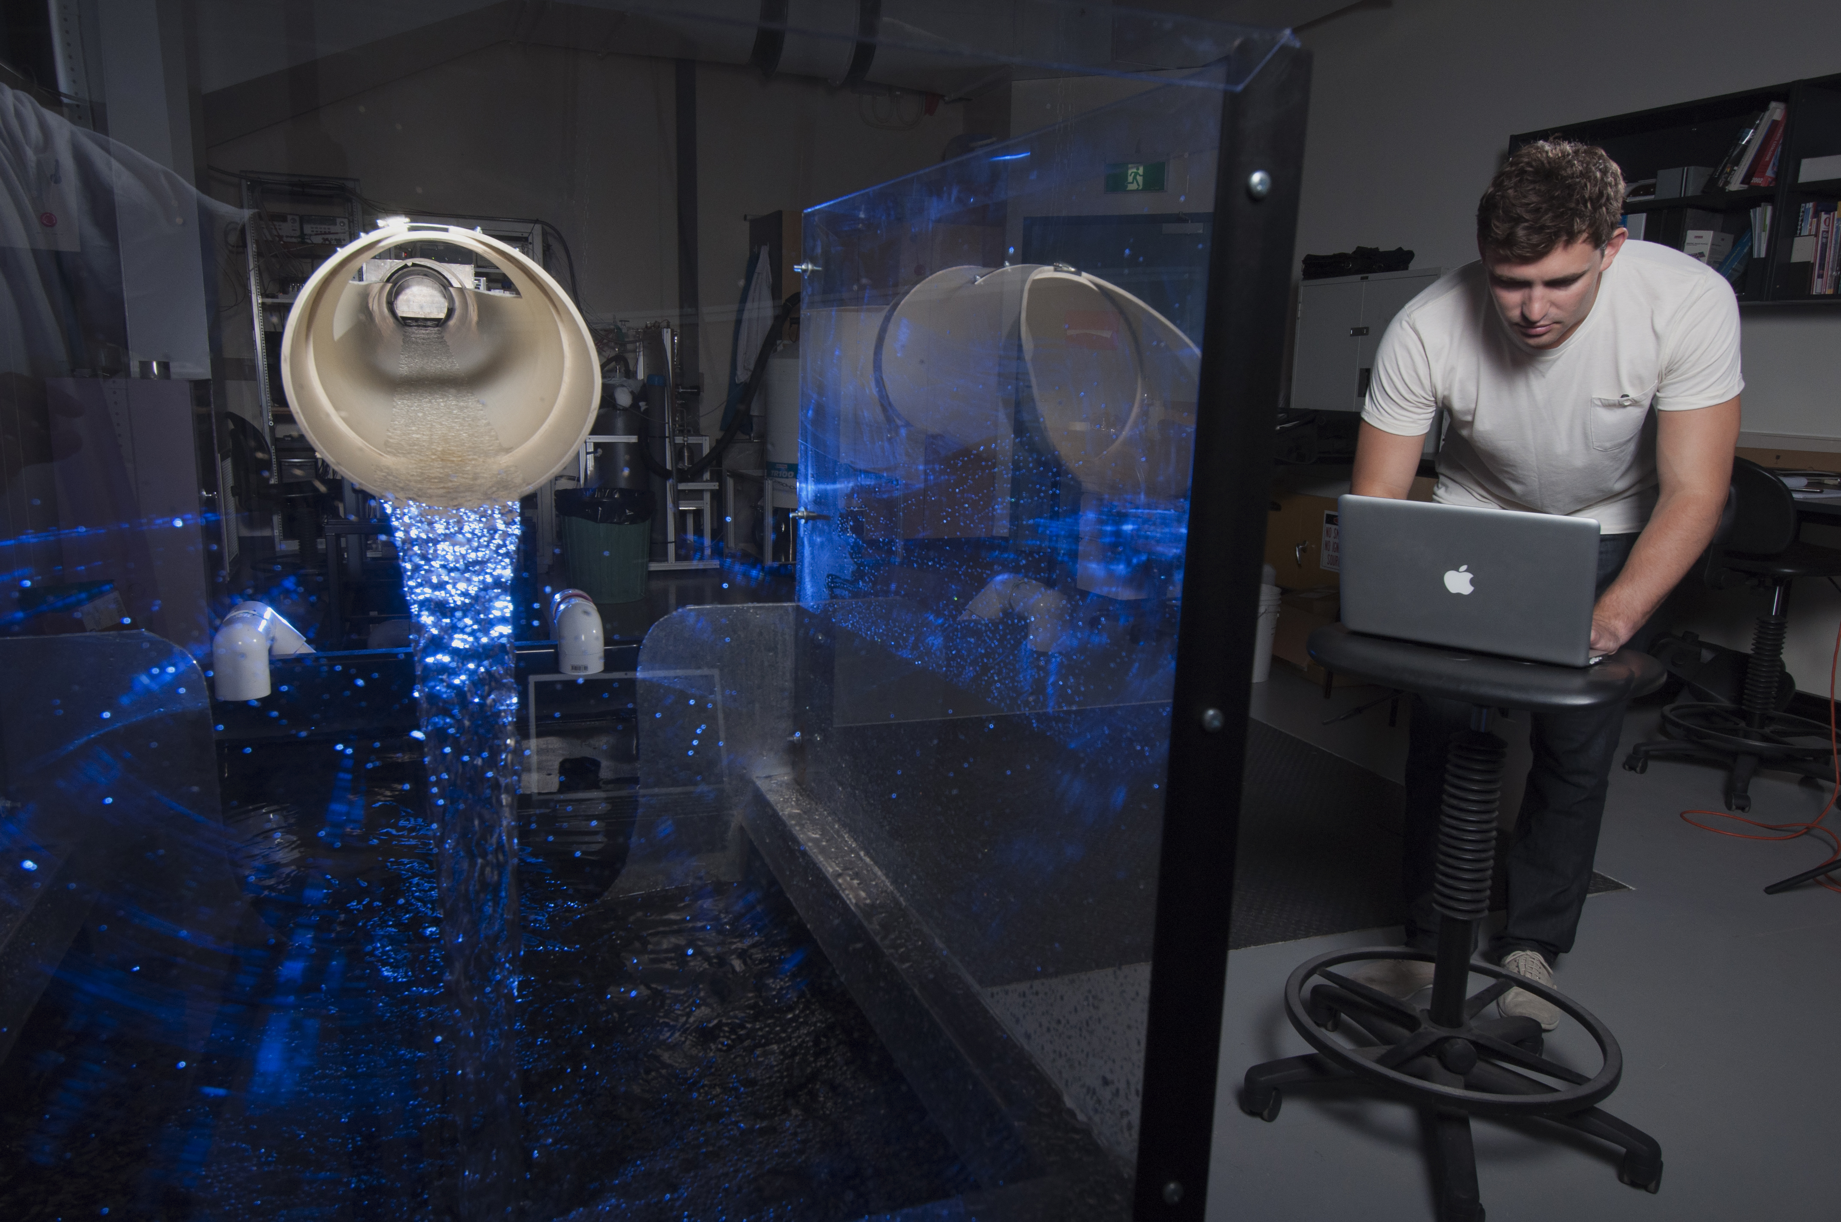
CEED
CEED Induction 2016/2017
Jeremy Leggoe Amanda Bolt
CEED Director CEED Administrator

Slide 2
Schedule
9:00 – 10:00 Session 1: Introduction to CEED Projects
10:00 – 10:30 Morning Tea
10:30 – 12:30 Session 2: Project Initiation
12:30 – 1:15 Lunch
1:15 – 2:45 Session 3: Communication
2:45 – 3:15 Afternoon Tea
3:15 – 4:30 Session 4: Project Execution

Slide 3
Session 1
Introduction to CEED Projects
Title

Slide 4
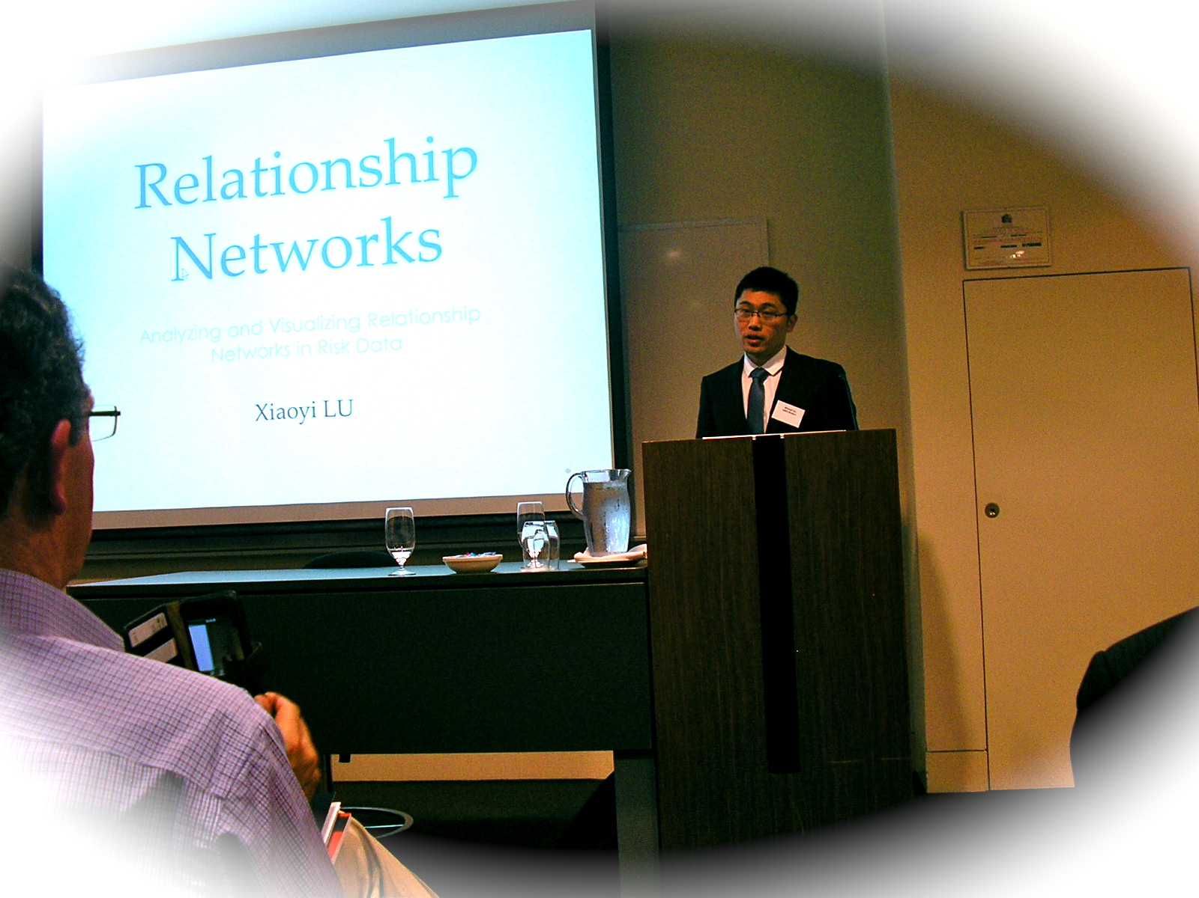
The Mission of the CEED Program
To provide students with the opportunity to undertake research projects dealing with real industry issues.
To provide students with experience in a professional environment, preparing them for the transition to graduate roles.
To develop the professional skills of our students, and prepare them for working under the constraints and conditions experienced in professional environments
To engage industry with UWA, demonstrating the benefits of applied research, laying the foundation for deeper engagement.
To engage our academic staff with industry, both raising their profile and exposing them to current industry priorities.

Slide 5
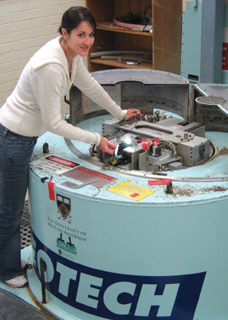
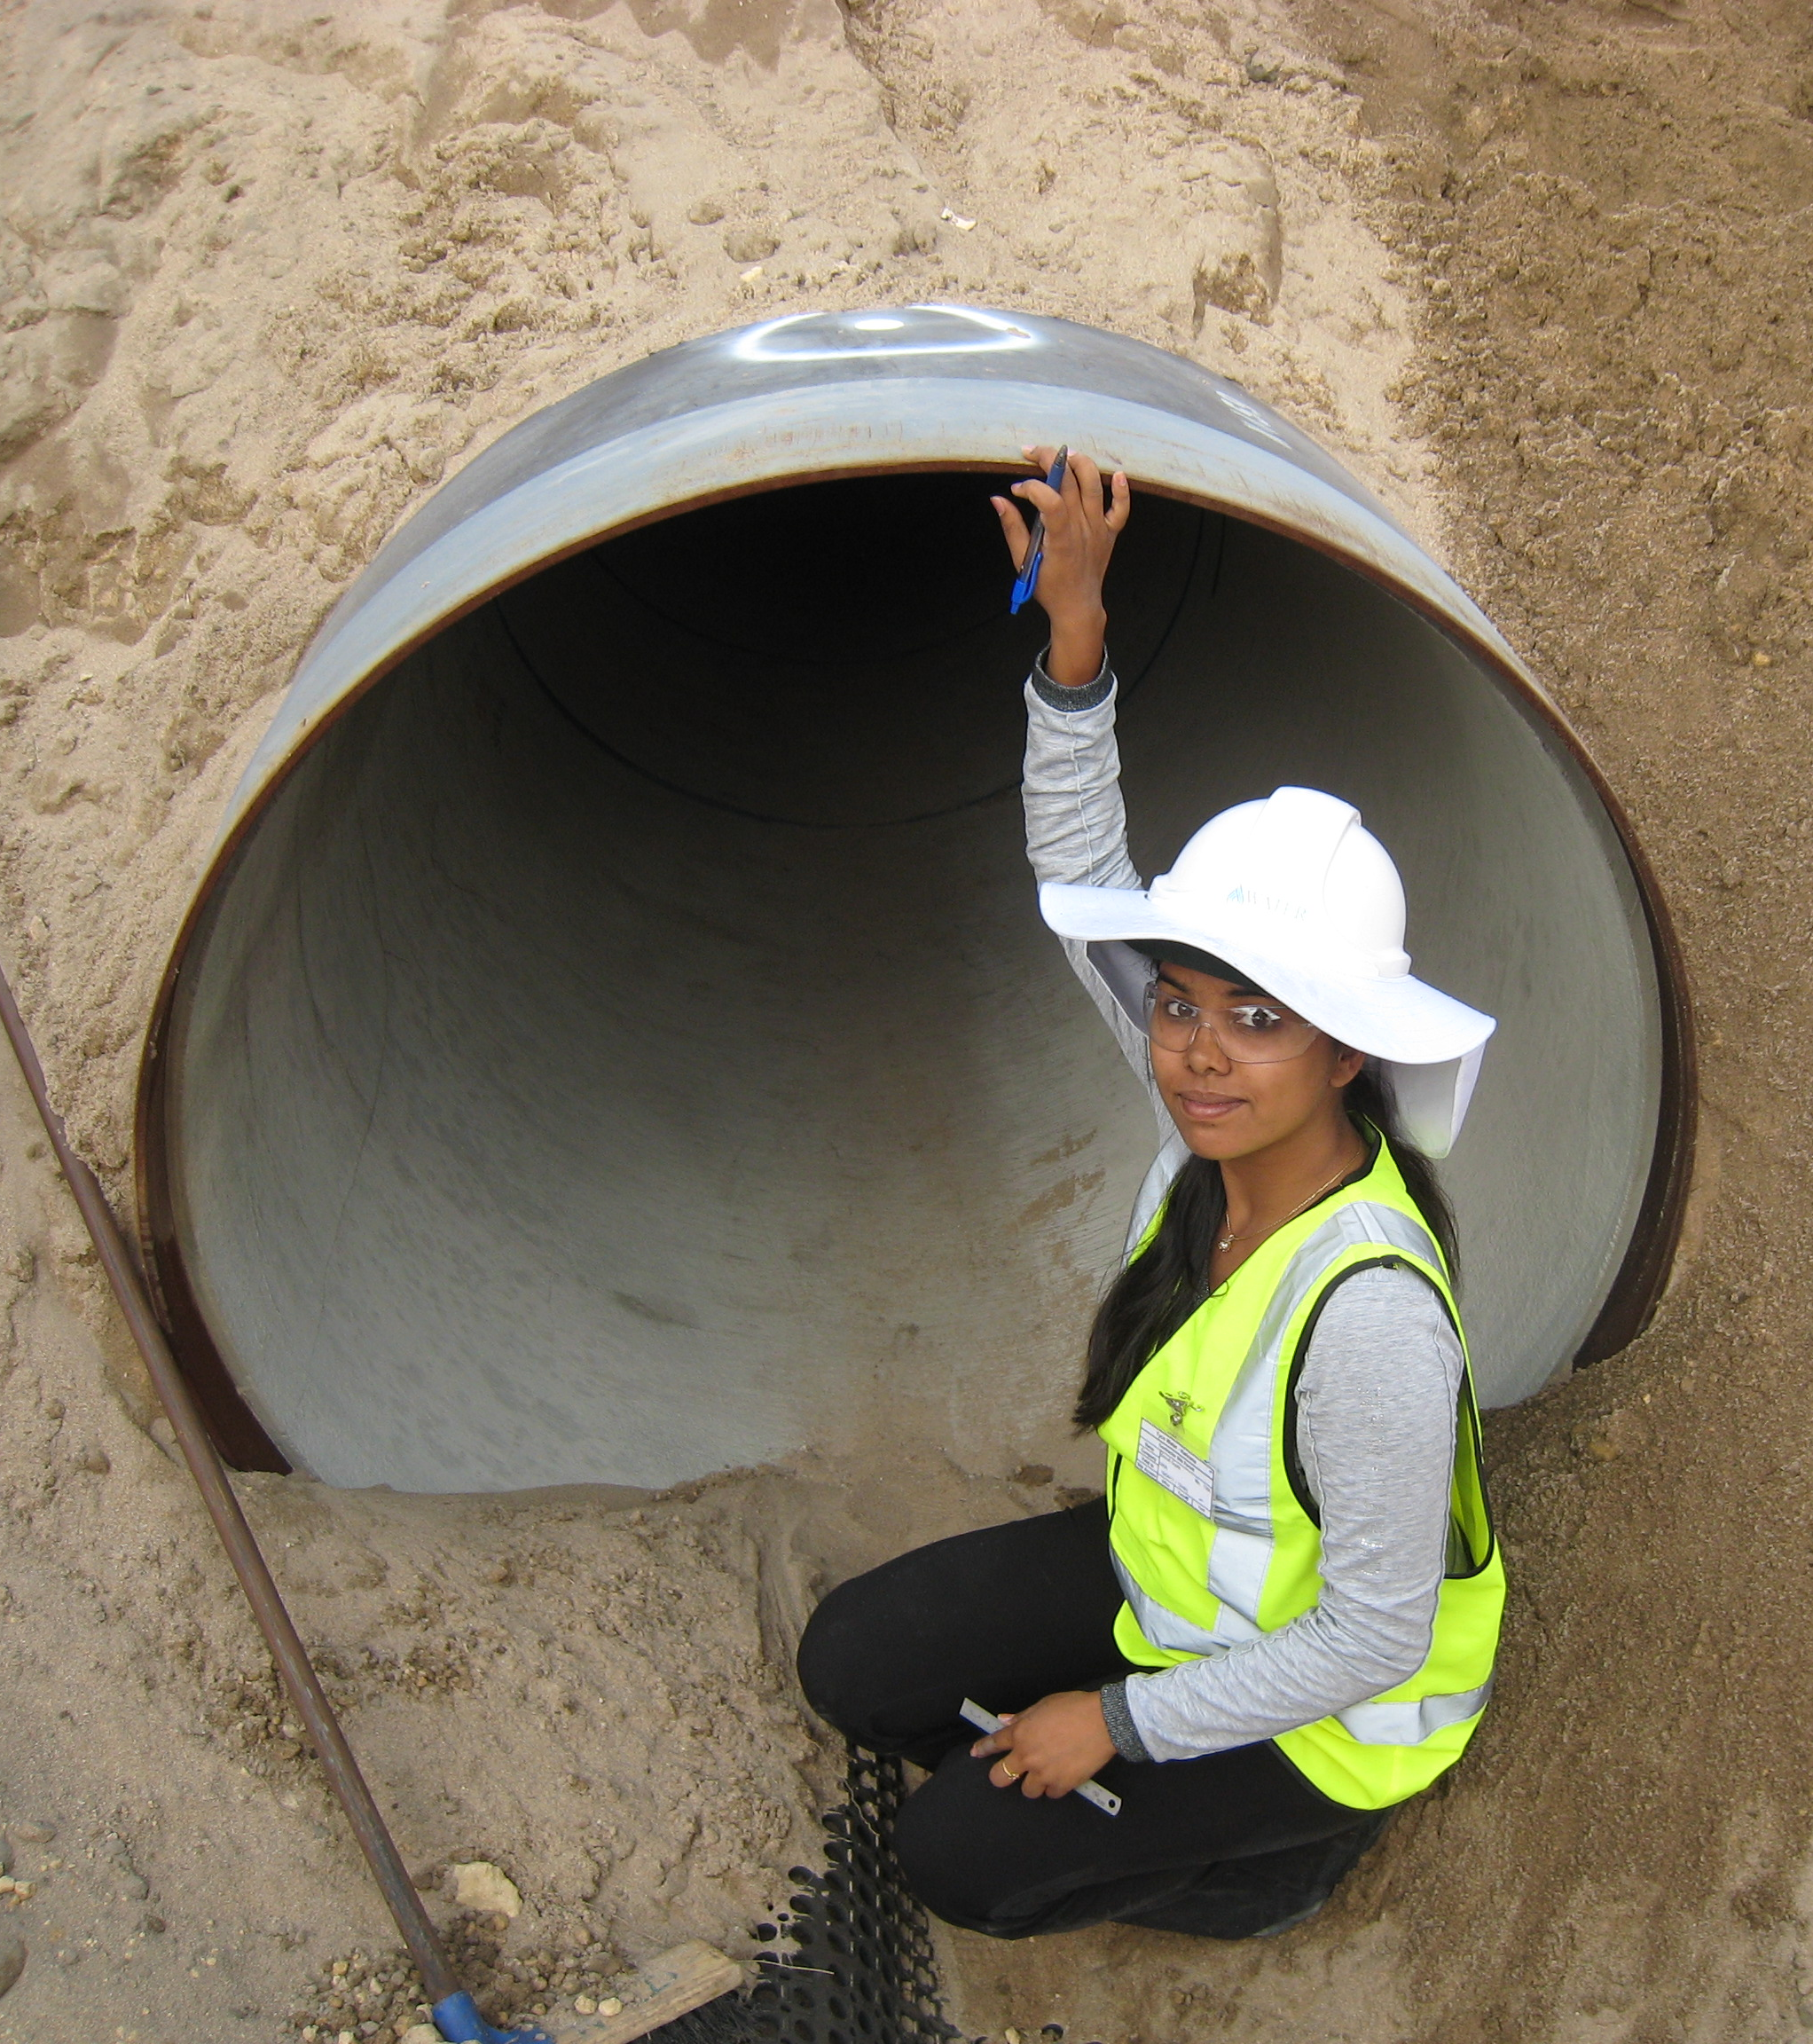
28 Years of CEED
The CEED concept originated at RMIT, and with federal government support CEED was founded at UWA (and several other universities) in 1989.
With the withdrawal of government funding, CEED at UWA became self sufficient, and is one of only three CEED programs that continue today.
The program was founded in Mech Engineering, expanding over time to accommodate any discipline.
By the end of 2014 we will have completed over 450 CEED projects at UWA.
At present we typically complete 20-25 projects each year, representing (industry funded) research expenditures of ≈ $320,000 per annum
In several companies, CEED is aligned with their vacation and graduate hiring programs

Slide 6
CEED Project Development
The CEED office is in constant contact with industry to identify and develop opportunities.
  Delivering presentations on-site
  Developing relationships with HR organisations
  Developing relationships with contacts
  Maintaining relationships with our alumni
  Maintaining a web and media presence
Opportunities are referred to the CEED office by the Faculty, Energy & Minerals Institute, Development and Alumni Relations, and the Office of Research Enterprise.
Academic staff develop projects with their own contacts, and we then facilitate the projects.
Students develop relationships with industry, and engage us to facilitate the project.

Slide 7
Personal Capital in CEED Projects
Staff members at the CEED Client have championed the project within their enterprise, which is expecting success.
Your Academic Supervisors will be looking for opportunities for future interaction with the Client.
The University’s reputation as a world-class research institution rides on every external interaction.
The ability of the CEED Program to secure future projects is dependent on the success of current projects.
YOUR reputation in industry is dependent on your approach to the project – a CEED project is a chance to make a good name for yourself in the Client enterprise, which can pay dividends in unexpected ways in the future.

Slide 8
Features of CEED Projects
CEED projects have a defined commercial objective
  CEED projects have defined deliverables, which are intended to create benefits for the Client enterprise
CEED projects provide students with experience in operating in a professional environment
  To make effective progress on the project you will need to develop a network in the client enterprise.
  To gather and deliver information, you will need to become skilled in professional communication.
  CEED project findings must be grounded in commercial reality
CEED projects are supported by the client, the CEED Office and UWA
  CEED clients support the projects with resources and expertise.
  Academic supervisors contribute their expertise.
  CEED Office staff provide an additional source of expertise.

Slide 9
Performance of CEED Scholars on FYP

Slide 10
Effective Communication
Rhetoric
  The art of speaking or writing effectively
In Aristotle’s classical view, rhetoric consists of three elements
  Ethos – establishing the character or credibility of the speaker (ie – Does the speaker have the experience or background to make the argument?)
  Logos – The logic of the discussion (ie – Does the Discussion make sense? Are the statements accurate?)
  Pathos – The appeal to the emotions or sympathies of the audience (ie – Why would the audience get on board with a proposal? Why do they care?)

Slide 11
Exercise - Communication
You have 60 seconds to describe your project to an audience made up of staff members from your client.
The 60 seconds will be timed – you will be cut-off at exactly 60 seconds.
You have 10 minutes to work individually to prepare your address.
You will not be allowed to use notes during your address
The group will provide feedback on how successfully you have addressed the elements of ethos, logos and pathos.

Slide 12
Session 2
Project Initiation

Slide 13
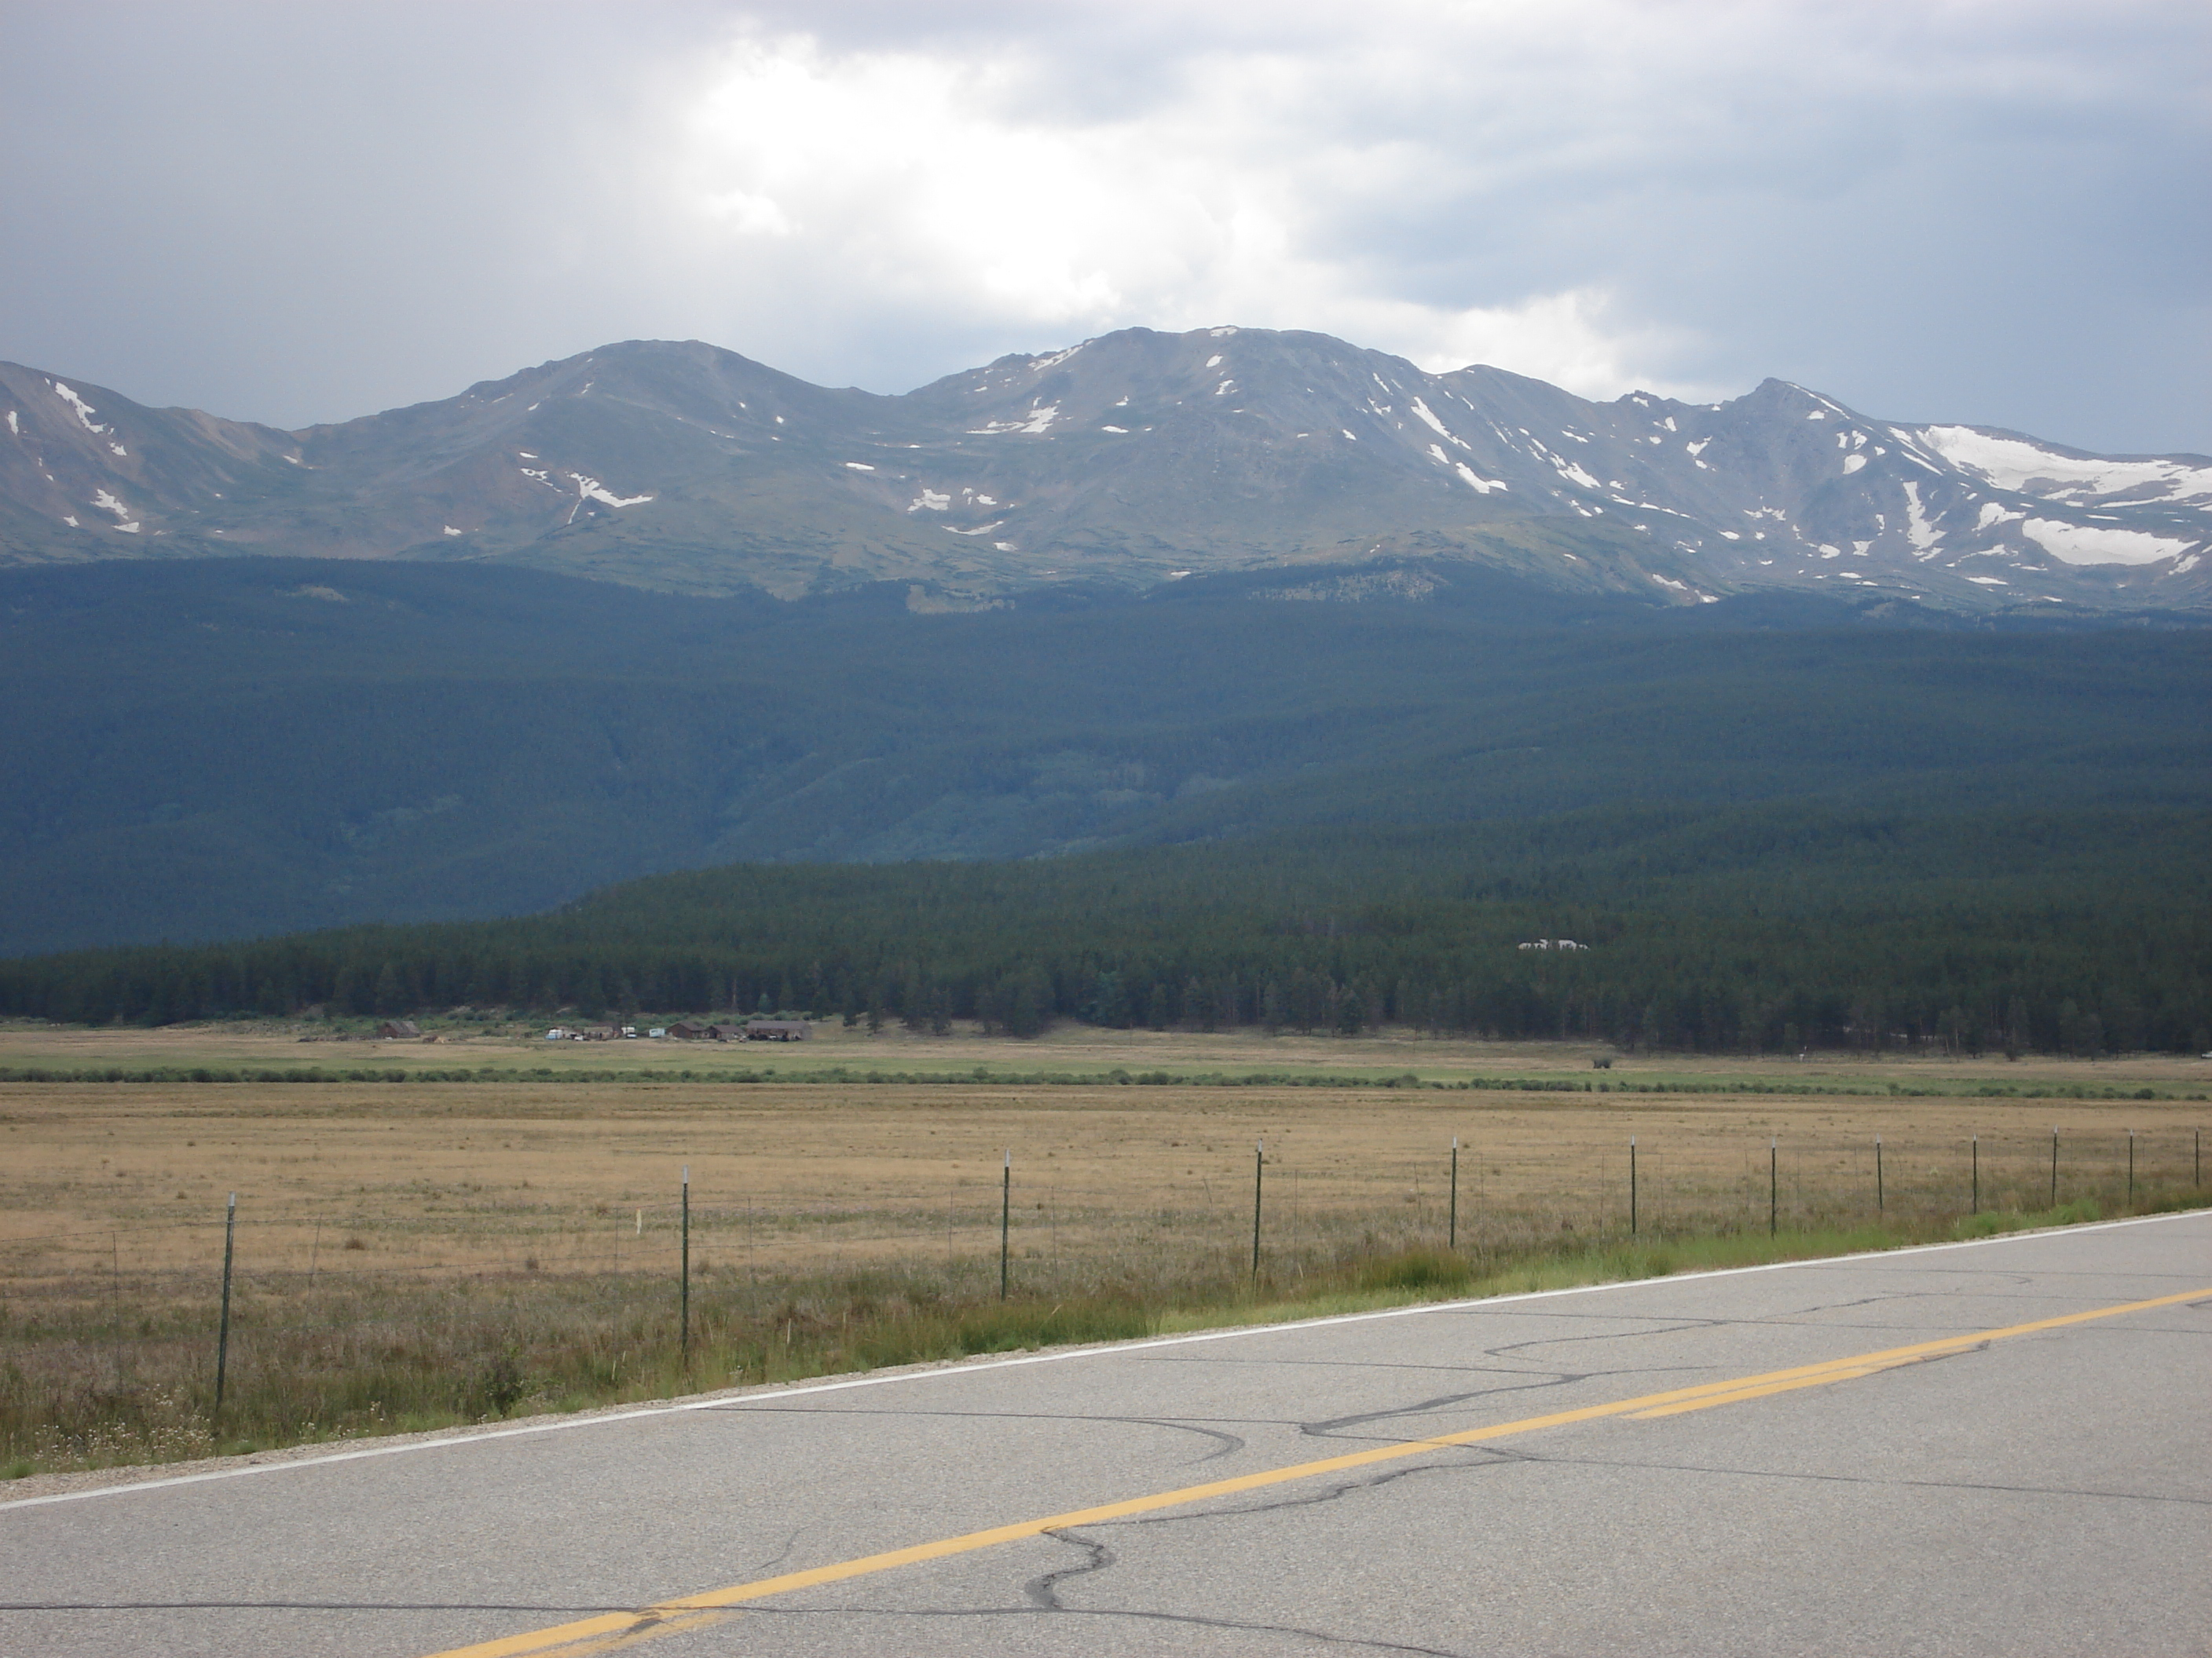
Goal
You are Here

Slide 14
Getting Started on the Project
Meet with your academic supervisor to discuss their ideas and expectations for the project.
Start work on your literature review.
Meet with your Client Mentor to discuss their ideas and expectations for the project
Start compiling the Project Brief, and complete the project brief within 8-10 weeks of staring work on the project
Notes:
While we all hope your CEED project start-up will go smoothly and according to plan, sometimes there are unavoidable delays. Aim to achieve as much as possible of the following before you start site work. In some cases that will not be possible, in which case, simply achieve what you can and aim to get the rest done in the early part of the first site work period.
Whatever your starting date, you will not make much progress on the actual solution of the problem before starting site work. Helpful goals would be to:
know exactly what you are setting out to achieve, and why;
have composed, agreed upon, and signed the Project Brief;
have planned how you will set about tackling the work;
have requested the resources needed at the CEED Partner's site and the university;
have started accumulating relevant reference material;
have set up the structure for your planning and documentation system;
have begun to build up key skills and knowledge;
be ready to outline your approach in a brief presentation.
It is very beneficial for you to be ready for more detailed work by the time you commence work on site.

Slide 15
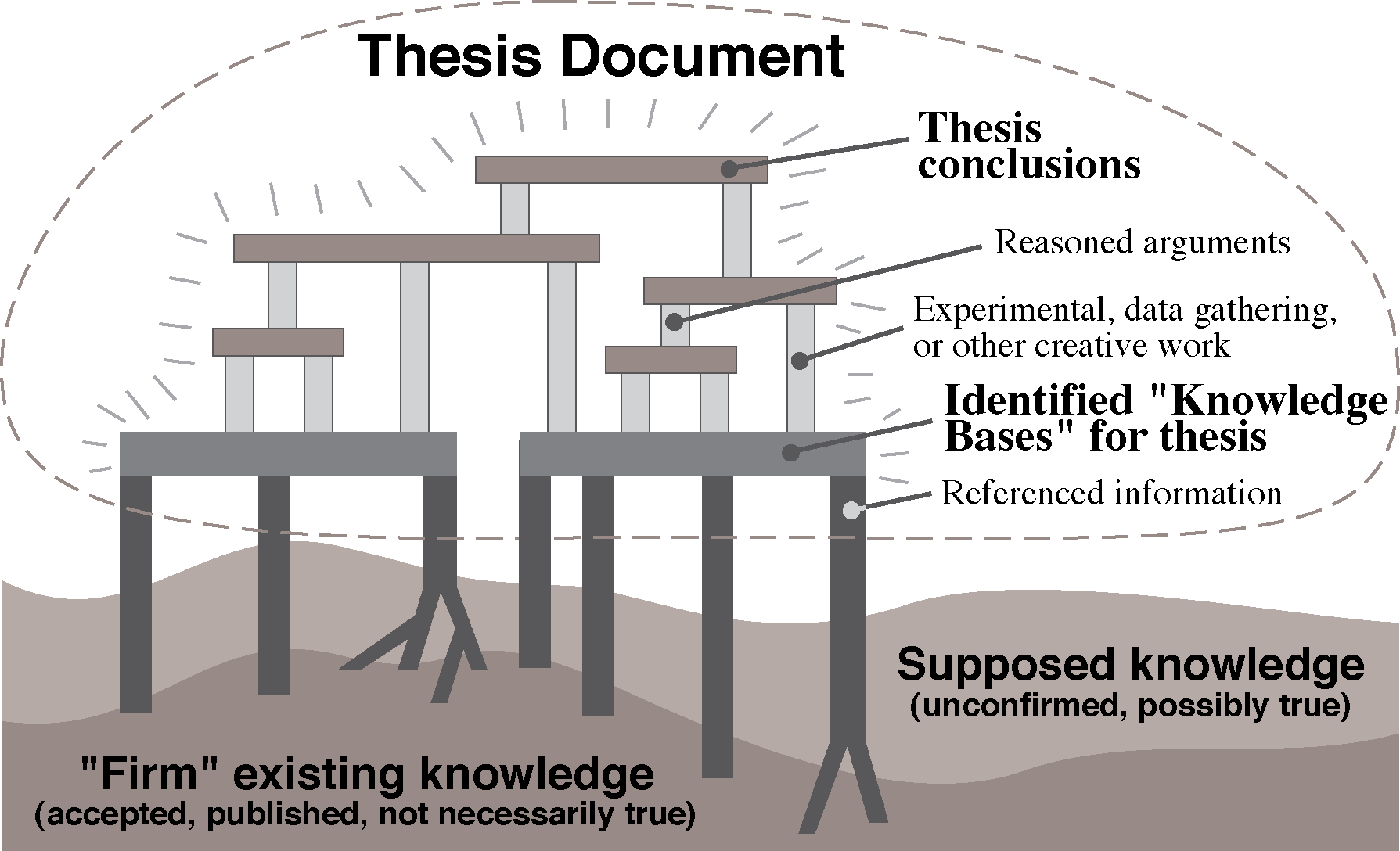
Building a Foundation for the Project

Slide 16
Every statement and conclusion in a professional report must be supported by accepted literature or your results and deductions

Slide 17
What is a Literature Review?
The literature review is the first step in any successful research effort, and will continue throughout the project
The purpose of the literature review is to establish the state of the art in the area that you are working in.
  For investigative research, this will mean reviewing the academic literature.
  For design projects, this will mean identifying current approaches to solving the problem of interest (or similar problems)
  For industrial projects, this will entail reviewing standards and current operating practices.
  In CEED projects, this will also require reviewing internal documents to determine the history of the issue within the client enterprise

Slide 18
Basic Tools
Internet search engines have greatly simplified the process of identifying information sources.
Google, Wikipedia and Media sites can and should be used to provide a quick overview of a field
  Use to identify relevant publications and experts.
  Can help with basic definitions or even formulae.
However, it must be remembered that it is generally UNACCEPTABLE to reference these sources in a thesis
  The reviewing and control of posted data ranges from inconsistent to non-existent.
  It can be difficult to assess the expertise (or motives) of the poster.
Notes:
While we all hope your CEED project start-up will go smoothly and according to plan, sometimes there are unavoidable delays. Aim to achieve as much as possible of the following before you start site work. In some cases that will not be possible, in which case, simply achieve what you can and aim to get the rest done in the early part of the first site work period.
Whatever your starting date, you will not make much progress on the actual solution of the problem before starting site work. Helpful goals would be to:
know exactly what you are setting out to achieve, and why;
have composed, agreed upon, and signed the Project Brief;
have planned how you will set about tackling the work;
have requested the resources needed at the CEED Partner's site and the university;
have started accumulating relevant reference material;
have set up the structure for your planning and documentation system;
have begun to build up key skills and knowledge;
be ready to outline your approach in a brief presentation.
It is very beneficial for you to be ready for more detailed work by the time you commence work on site.

Slide 19
Expert Materials
A research report should rely on peer reviewed and/or edited materials such as
  Books
  Scientific Journal Articles
  Scientific Conference Proceedings
The UWA library is an excellent research library
  In addition to the materials in the stacks, there is a wide range of journals available electronically
  If a particular paper or book is not available, the library can generally locate a copy via inter-library loan relatively quickly. This service (GETIT) is free to students enrolled in final year, honours, and postgraduate projects
Notes:
While we all hope your CEED project start-up will go smoothly and according to plan, sometimes there are unavoidable delays. Aim to achieve as much as possible of the following before you start site work. In some cases that will not be possible, in which case, simply achieve what you can and aim to get the rest done in the early part of the first site work period.
Whatever your starting date, you will not make much progress on the actual solution of the problem before starting site work. Helpful goals would be to:
know exactly what you are setting out to achieve, and why;
have composed, agreed upon, and signed the Project Brief;
have planned how you will set about tackling the work;
have requested the resources needed at the CEED Partner's site and the university;
have started accumulating relevant reference material;
have set up the structure for your planning and documentation system;
have begun to build up key skills and knowledge;
be ready to outline your approach in a brief presentation.
It is very beneficial for you to be ready for more detailed work by the time you commence work on site.

Slide 20
Expert Search Tools
Compendex, also formerly known as “Engineering Index” provides a list of papers matching your specified search terms.
  To access
    Type “Compendex” into the OneSearch text entry space
    Click on the “view online” link that appears under the first search result in the list.
  Compendex finds both journal papers and conference proceedings (Web of Knowledge focuses on journal papers)
The “Web of Knowledge” provides a similar capability but can be more powerful because it also provides a Citation Index.
  The number of citations tells you how influential a paper is.
  You can follow a “citation trail” from an important paper to research the current state of knowledge in a field.
  To access : Type “Web of Knowledge” into OneSearch, and the proceed as for Compendex.
Notes:
While we all hope your CEED project start-up will go smoothly and according to plan, sometimes there are unavoidable delays. Aim to achieve as much as possible of the following before you start site work. In some cases that will not be possible, in which case, simply achieve what you can and aim to get the rest done in the early part of the first site work period.
Whatever your starting date, you will not make much progress on the actual solution of the problem before starting site work. Helpful goals would be to:
know exactly what you are setting out to achieve, and why;
have composed, agreed upon, and signed the Project Brief;
have planned how you will set about tackling the work;
have requested the resources needed at the CEED Partner's site and the university;
have started accumulating relevant reference material;
have set up the structure for your planning and documentation system;
have begun to build up key skills and knowledge;
be ready to outline your approach in a brief presentation.
It is very beneficial for you to be ready for more detailed work by the time you commence work on site.

Slide 21
Web of Knowledge
http://www.is.uwa.edu.au/

Slide 22
Approach
Remember that the word “review” is important – it is not a literature “survey”
It is essential to read the material you find carefully and critically.
  Does the material apply directly to your work?
  What are the limitations of the published material?
A good paper or book will usually be well referenced – the reference lists can help you find older, more fundamental work in a field
  A good literature review will evolve and expand from each paper you review.
  Fundamental papers can often make it easier to understand the topic you are researching

Slide 23
Approach
IMPORTANTLY - do not limit your consideration of literature to recent works.
  Fundamental papers and texts can often make it easier to understand a particular technique or approach.
  In seminal papers, the jargon of the field has usually not yet developed – so the text is often more comprehensible
  The basis and limits of a particular approach can also often be more clearly identified in the original papers.
  So don’t ignore the dusty old journals! In many fields, the basis of current thinking was laid out a long time ago.

Slide 24
“If I have seen farther than others, it is because I have stood on the shoulders of giants.”
Sir Isaac Newton
Notes:
While we all hope your CEED project start-up will go smoothly and according to plan, sometimes there are unavoidable delays. Aim to achieve as much as possible of the following before you start site work. In some cases that will not be possible, in which case, simply achieve what you can and aim to get the rest done in the early part of the first site work period.
Whatever your starting date, you will not make much progress on the actual solution of the problem before starting site work. Helpful goals would be to:
know exactly what you are setting out to achieve, and why;
have composed, agreed upon, and signed the Project Brief;
have planned how you will set about tackling the work;
have requested the resources needed at the CEED Partner's site and the university;
have started accumulating relevant reference material;
have set up the structure for your planning and documentation system;
have begun to build up key skills and knowledge;
be ready to outline your approach in a brief presentation.
It is very beneficial for you to be ready for more detailed work by the time you commence work on site.

Slide 25
Exercise – Literature Review
Identify bodies of literature relevant to your project.
Identify search keywords relevant to those bodies of literature.
Work in pairs (or a trio). Discuss your keywords, and bounce ideas off each other
After 10 minutes discussion, we will go through a sample search for a few projects with the group.

Slide 26
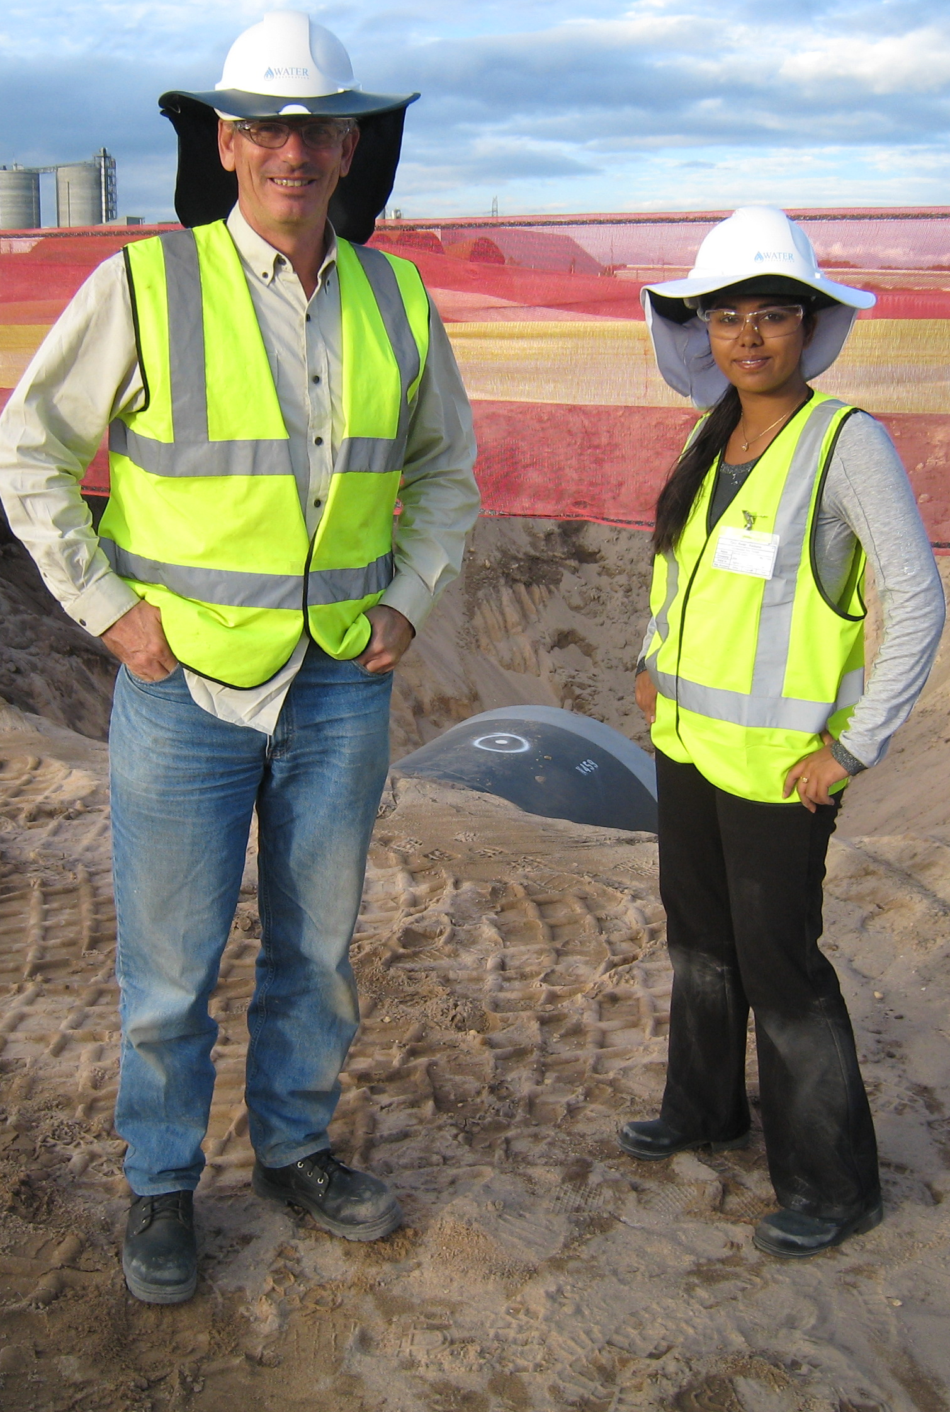
Initial Meeting With the Client
The first meeting is an opportunity to set the tone for the partnership
  Be prepared (technically)
  Dress professionally (or appropriately, for site visits)
  Coordinate with your supervisor before meeting the client (if possible)
  Be prepared to network with client staff
  Relax – remember, every one at the meeting wants the project (and therefore you) to succeed.

Slide 27
Initial Meeting with the Client – Overview Questions
What objectives is the Client seeking to achieve?
What is the history of the issue/project within the Client enterprise?
What benefits does the Client seek from achieving those benefits?
What would the Client like as primary and secondary objectives?
  Ensure Mentor understands the academic requirements of the project
What deliverables is the Mentor expecting?
  Report only, software, working prototype ?
What is the preliminary timetable for project?
  Do not agree to commercial deadlines

Slide 28
Initial Meeting with the Client - Resources
What constraints will be imposed on the approach to solving the problem
  How will you need to fit in with other Client activities, products or policies?
What resources does the Mentor think are needed? Does the Client already have them?
What resources (e.g. labs and equipment) does the Mentor hope UWA will provide?
Will any special test rigs be needed? Where will they be built or sourced?
Will items be ordered specially?
  Do you need to provide information? By when? Who will order the items?

Slide 29
Initial Meeting with the Client – Client Factors
Is any information needed urgently for budgeting?
What mechanisms will be followed to approve expenditure?
Which Client personnel have interest in the project and its benefits?
Which Client personnel have relevant expertise?
Agree on communication channels:
  frequency of reports/meetings?
  good days/times (or bad) to contact Mentor?
Who will act as “deputy” Mentor when the Mentor is unavailable?

Slide 30
Initial Meeting with the Client – Site Work
When can you visit the site to familiarise yourself with the environment?
  Are there any special requirements for site work (sites, medicals, safety training, special clothing)?
Agree on the duration and timing of site work
Will there be any HR Department people involved?
How best can you make contact with such people?

Slide 31
Exercise – Initial Meeting
Working in your pairs (or trios), come up with an initial list of questions for your first meeting with the client mentor.
  If you’ve already had that meeting – which questions did you ask, and which new questions do you need to ask now?
  What questions have you asked your supervisor, and what questions do you need to ask?
  Working in your pairs (or trios), come up with an initial list of questions for your first meeting with the client mentor.
  Identify the 3 most important questions for discussion

Slide 32

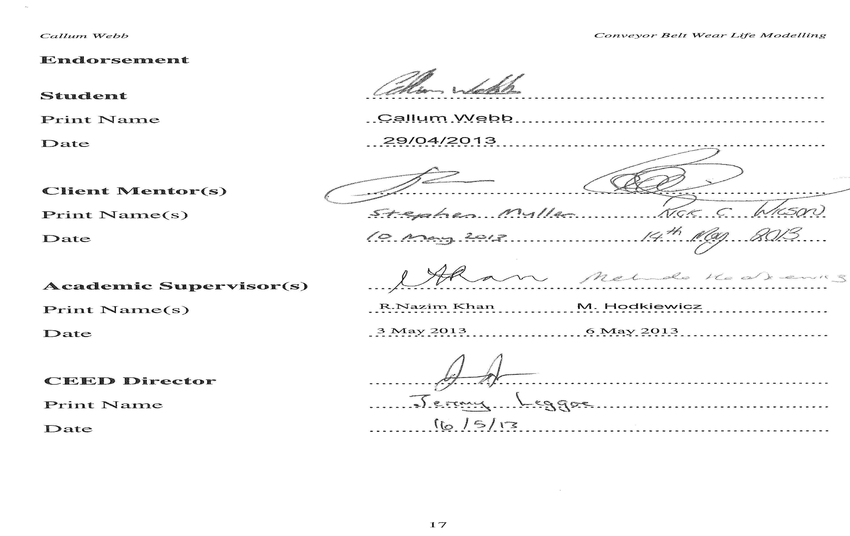
Project Brief

Slide 33
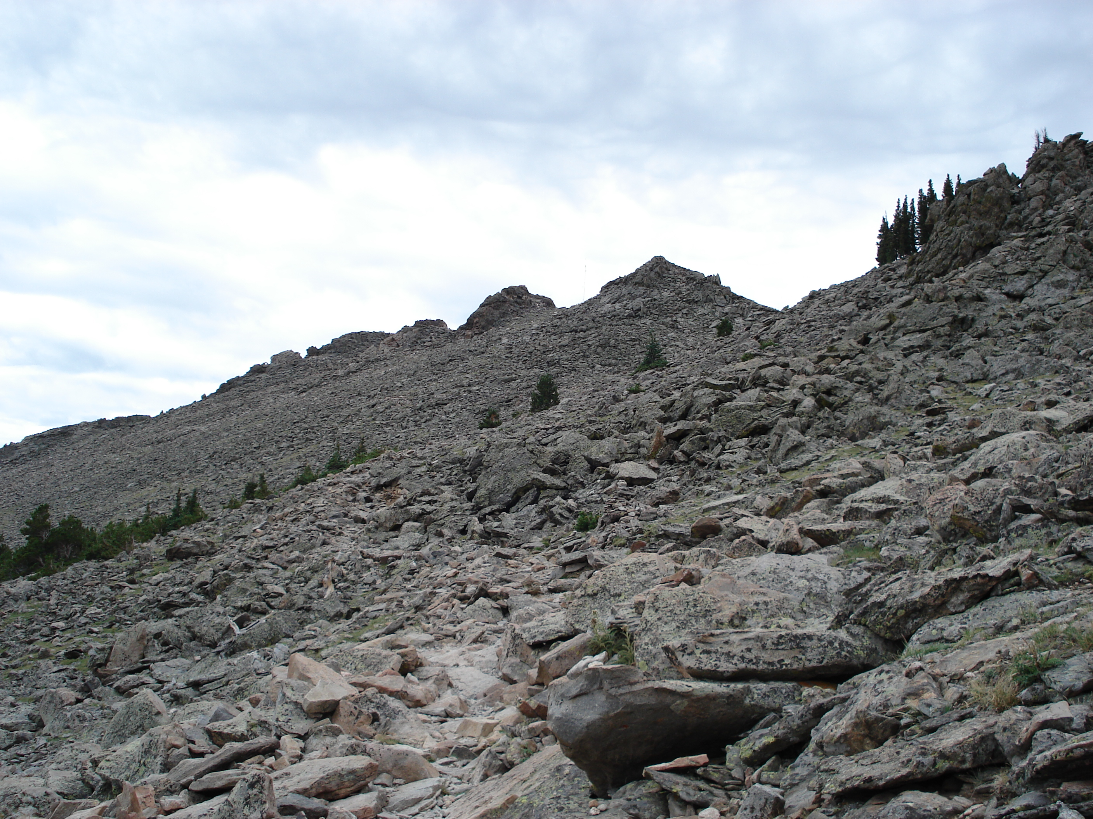

Slide 34
Objective?
?
?
?
Path?

Slide 35
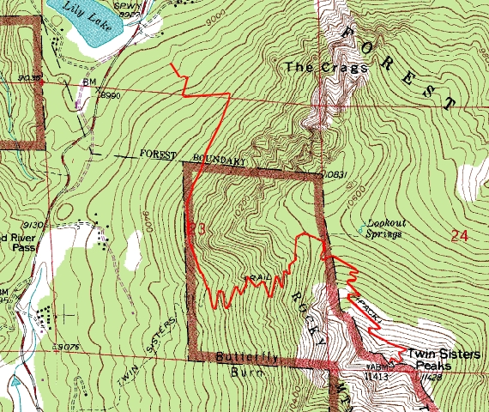

Slide 36
Project Brief Template
http://www.ceed.uwa.edu.au/forms
Notes:
While we all hope your CEED project start-up will go smoothly and according to plan, sometimes there are unavoidable delays. Aim to achieve as much as possible of the following before you start site work. In some cases that will not be possible, in which case, simply achieve what you can and aim to get the rest done in the early part of the first site work period.
Whatever your starting date, you will not make much progress on the actual solution of the problem before starting site work. Helpful goals would be to:
know exactly what you are setting out to achieve, and why;
have composed, agreed upon, and signed the Project Brief;
have planned how you will set about tackling the work;
have requested the resources needed at the CEED Partner's site and the university;
have started accumulating relevant reference material;
have set up the structure for your planning and documentation system;
have begun to build up key skills and knowledge;
be ready to outline your approach in a brief presentation.
It is very beneficial for you to be ready for more detailed work by the time you commence work on site.

Slide 37
Cover Page and Summary
Project Summary
  In some respects, the summary is the most important element of any proposal or report
  For busy readers, the summary may be the only thing they read – it will ALWAYS be the first thing they read
The summary must provide a clear, concise description of
  The reasons for undertaking the project
  The project objectives
  The business value realised by achieving the objectives
  The methods by which the objectives will be achieved and expected costs
  The key deliverables

Slide 38
Project Background
1st Element – Problem Statement
  The specific issue addressed by the project
  Implications of the issue for the client
2nd Element – Background Information
  Current Situation
  History of the issue in the client enterprise
  State of the art (from early literature review)
3rd Element – Current and Future Environment
  How does the environment affect the motivations and execution of the project
  Changes that may affect the project – Will new equipment or information become available? Is legislation changing?
Notes:
While we all hope your CEED project start-up will go smoothly and according to plan, sometimes there are unavoidable delays. Aim to achieve as much as possible of the following before you start site work. In some cases that will not be possible, in which case, simply achieve what you can and aim to get the rest done in the early part of the first site work period.
Whatever your starting date, you will not make much progress on the actual solution of the problem before starting site work. Helpful goals would be to:
know exactly what you are setting out to achieve, and why;
have composed, agreed upon, and signed the Project Brief;
have planned how you will set about tackling the work;
have requested the resources needed at the CEED Partner's site and the university;
have started accumulating relevant reference material;
have set up the structure for your planning and documentation system;
have begun to build up key skills and knowledge;
be ready to outline your approach in a brief presentation.
It is very beneficial for you to be ready for more detailed work by the time you commence work on site.

Slide 39
Objectives & Benefits
1st Element – Objectives
  What are the specific objectives to be achieved by the project?
2nd Element – Benefits Analysis
  Describe the business value realised by the client through the implementation of the deliverables
    Financial consequences
    EH&S improvements
    Improvements in KPIs
    Policy formulation
Notes:
While we all hope your CEED project start-up will go smoothly and according to plan, sometimes there are unavoidable delays. Aim to achieve as much as possible of the following before you start site work. In some cases that will not be possible, in which case, simply achieve what you can and aim to get the rest done in the early part of the first site work period.
Whatever your starting date, you will not make much progress on the actual solution of the problem before starting site work. Helpful goals would be to:
know exactly what you are setting out to achieve, and why;
have composed, agreed upon, and signed the Project Brief;
have planned how you will set about tackling the work;
have requested the resources needed at the CEED Partner's site and the university;
have started accumulating relevant reference material;
have set up the structure for your planning and documentation system;
have begun to build up key skills and knowledge;
be ready to outline your approach in a brief presentation.
It is very beneficial for you to be ready for more detailed work by the time you commence work on site.

Slide 40
Execution - Methodology
The methodology sets out the process by which the objectives will be accomplished
Break down the project into specific tasks, and describe the approach that will be taken to accomplishing each.
  Experimental/Field tasks: describe equipment and techniques
  Modelling tasks: identify software and computing resources
  Theoretical tasks: identify approaches under consideration
  Design tasks: identify tools or approaches
  Financial tasks: describe tools and analytical techniques
  Survey Tasks: describe approach and target populations
Identify any constraints imposed on the methodology
This is often the weakest element in poor briefs
  You should provide specific detail – vague ideas are not enough. Careful planning is critical
Notes:
While we all hope your CEED project start-up will go smoothly and according to plan, sometimes there are unavoidable delays. Aim to achieve as much as possible of the following before you start site work. In some cases that will not be possible, in which case, simply achieve what you can and aim to get the rest done in the early part of the first site work period.
Whatever your starting date, you will not make much progress on the actual solution of the problem before starting site work. Helpful goals would be to:
know exactly what you are setting out to achieve, and why;
have composed, agreed upon, and signed the Project Brief;
have planned how you will set about tackling the work;
have requested the resources needed at the CEED Partner's site and the university;
have started accumulating relevant reference material;
have set up the structure for your planning and documentation system;
have begun to build up key skills and knowledge;
be ready to outline your approach in a brief presentation.
It is very beneficial for you to be ready for more detailed work by the time you commence work on site.

Slide 41
Execution - Timeline
Scheduling the project elements is an essential part of research plan development
The timeline should be described in two distinct ways:
  A Gantt chart is required
  The key milestones should be listed and discussed
Consider the following key questions;
  How long will each task take?
  How variable is the predicted time for each task?
  Which tasks can be done concurrently?
  Which tasks have prerequisites?
  Which tasks lie on the critical path?
Discuss any key constraints on the proposed timeline
Notes:
While we all hope your CEED project start-up will go smoothly and according to plan, sometimes there are unavoidable delays. Aim to achieve as much as possible of the following before you start site work. In some cases that will not be possible, in which case, simply achieve what you can and aim to get the rest done in the early part of the first site work period.
Whatever your starting date, you will not make much progress on the actual solution of the problem before starting site work. Helpful goals would be to:
know exactly what you are setting out to achieve, and why;
have composed, agreed upon, and signed the Project Brief;
have planned how you will set about tackling the work;
have requested the resources needed at the CEED Partner's site and the university;
have started accumulating relevant reference material;
have set up the structure for your planning and documentation system;
have begun to build up key skills and knowledge;
be ready to outline your approach in a brief presentation.
It is very beneficial for you to be ready for more detailed work by the time you commence work on site.

Slide 42
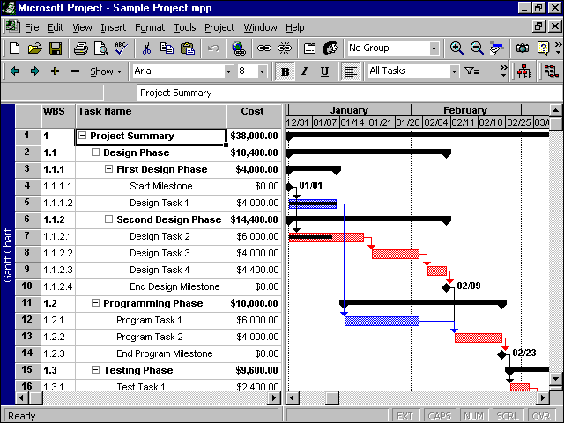
Execution – Gantt Chart
Notes:
While we all hope your CEED project start-up will go smoothly and according to plan, sometimes there are unavoidable delays. Aim to achieve as much as possible of the following before you start site work. In some cases that will not be possible, in which case, simply achieve what you can and aim to get the rest done in the early part of the first site work period.
Whatever your starting date, you will not make much progress on the actual solution of the problem before starting site work. Helpful goals would be to:
know exactly what you are setting out to achieve, and why;
have composed, agreed upon, and signed the Project Brief;
have planned how you will set about tackling the work;
have requested the resources needed at the CEED Partner's site and the university;
have started accumulating relevant reference material;
have set up the structure for your planning and documentation system;
have begun to build up key skills and knowledge;
be ready to outline your approach in a brief presentation.
It is very beneficial for you to be ready for more detailed work by the time you commence work on site.

Slide 43
Exercise – Gantt Chart
Prepare a Gantt chart for your project
  Working individually, break down the project into tasks with identifiable outcomes and lengths.
  Draw up your Gantt Chart on the west wall whiteboards
The group will review and discuss the proposed timelines

Slide 44
Execution - Resources
You MUST identify any resources needed to undertake the proposed methodology
  Who will provide each resource (UWA or the client)?
  Check with your supervisor and mentor to ensure that resources are available
  Are the resources in place? If not, how long will it take to secure them?
Provide a detailed break down of any anticipated costs.
  The client must agree in advance to any expenditure
  Note any constraints imposed on expenditures (ie limit on total budget)
Notes:
While we all hope your CEED project start-up will go smoothly and according to plan, sometimes there are unavoidable delays. Aim to achieve as much as possible of the following before you start site work. In some cases that will not be possible, in which case, simply achieve what you can and aim to get the rest done in the early part of the first site work period.
Whatever your starting date, you will not make much progress on the actual solution of the problem before starting site work. Helpful goals would be to:
know exactly what you are setting out to achieve, and why;
have composed, agreed upon, and signed the Project Brief;
have planned how you will set about tackling the work;
have requested the resources needed at the CEED Partner's site and the university;
have started accumulating relevant reference material;
have set up the structure for your planning and documentation system;
have begun to build up key skills and knowledge;
be ready to outline your approach in a brief presentation.
It is very beneficial for you to be ready for more detailed work by the time you commence work on site.

Slide 45
Project Expenses
The CEED Client entirely funds the project.
You must comply with the accounting needs and procedures of the Client and the University.
Written approval must be secured before incurring any expenditure; the client will be under no obligation to pay if you do not.
You are responsible for the financial management of the project (under the oversight of your Supervisor and Mentor). Expenses must be reported monthly.
Estimated Project budget requirements should be set out in the project brief, and discussed with the client during the formulation of the project brief.

Slide 46
Risk Management
It’s essential that project managers understand potential problems, or “risks”, that may affect the project. They may then identify “risk management” strategies to eliminate or mitigate these risks.
Risks are classified into four broad types:
  Safety
  Environmental
  Financial
  Project Outcomes
Examples of each type of risk may be encountered in final year projects
In your brief, you are required to provide a section addressing the various types of risk

Slide 47
Risk Management (cont.)
Safety Risks;
  include those events that could potentially cause injury or death (both to participants and to bystanders)
  Safety (and Environmental) risks should be documented in the project safety induction form, which MUST be included with the proposal
Environmental Risks;
  include those events that could cause damage to the environment (such as spills, waste, gas releases)
Financial Risks;
  Include blow-outs in the cost of activities or equipment, which may prevent project progress or hamper other operations
Project Outcome Risks;
  Include events that may adversely affect the successful completion of the project

Slide 48
Risk Management (cont.)
Risk management approaches could include;
  Developing alternate approaches to cover equipment loss
  Identifying strategies in the event that partner opts out
  Identifying alternate techniques.
  Developing strategies to ensure security of data.
The brief must include a section on risk management. For each risk, you must provide;
  A brief description of the risk
  An assessment of the likelihood of the risk eventuating
  The consequences of the risk
  The management strategies to be adopted

Slide 49
Risk Management (cont.)
Note – It is imperative that your risk management section only include significant real risks
If there is no significant risk of a particular type, it is perfectly acceptable to clearly and simply state that there is no significant risk
Do not invent risks just to pad out the risk management section.
Each project will encounter different risks – but it is expected that all projects will be subject to risks to project outcomes.

Slide 50
Confidentiality
Is any of the information that you will be handling confidential (for IP, commercial, or publicity reasons)?
What are the procedures for clearing papers, presentations and theses for publication/submission?
  How many weeks in advance must they be submitted for approval? Note – for most companies, the process will take 3-4 weeks. Mentors are often unfamiliar with this – so take our word for it!
Will this thesis need to be held confidential? If so, why, and for how long?
It is essential that confidentiality requirements and clearance procedures be set out clearly in the project brief
Notes:
While we all hope your CEED project start-up will go smoothly and according to plan, sometimes there are unavoidable delays. Aim to achieve as much as possible of the following before you start site work. In some cases that will not be possible, in which case, simply achieve what you can and aim to get the rest done in the early part of the first site work period.
Whatever your starting date, you will not make much progress on the actual solution of the problem before starting site work. Helpful goals would be to:
know exactly what you are setting out to achieve, and why;
have composed, agreed upon, and signed the Project Brief;
have planned how you will set about tackling the work;
have requested the resources needed at the CEED Partner's site and the university;
have started accumulating relevant reference material;
have set up the structure for your planning and documentation system;
have begun to build up key skills and knowledge;
be ready to outline your approach in a brief presentation.
It is very beneficial for you to be ready for more detailed work by the time you commence work on site.

Slide 51
Deliverables
List all deliverables, specifying the format they are to be delivered in.
Deliverables may include
  Project Report
  Software
  Experimental Rigs
  Manuals for Software and Experimental Rigs
  Implementation plans
  etc
Notes:
While we all hope your CEED project start-up will go smoothly and according to plan, sometimes there are unavoidable delays. Aim to achieve as much as possible of the following before you start site work. In some cases that will not be possible, in which case, simply achieve what you can and aim to get the rest done in the early part of the first site work period.
Whatever your starting date, you will not make much progress on the actual solution of the problem before starting site work. Helpful goals would be to:
know exactly what you are setting out to achieve, and why;
have composed, agreed upon, and signed the Project Brief;
have planned how you will set about tackling the work;
have requested the resources needed at the CEED Partner's site and the university;
have started accumulating relevant reference material;
have set up the structure for your planning and documentation system;
have begun to build up key skills and knowledge;
be ready to outline your approach in a brief presentation.
It is very beneficial for you to be ready for more detailed work by the time you commence work on site.

Slide 52
Project Brief Preparation Process
Prepare First Draft
Send Draft for Review:
Supervisor, Mentor, CEED Director
Update Draft Based on Feedback
Receive Feedback (from all)
Changes Required
No Changes
Expect 1-2 Iterations of the Brief – and don’t collect any signatures until everyone has declared that the draft is acceptable
Collect Signatures
Bring to CEED office for Final Signature and Filing
Notes:
While we all hope your CEED project start-up will go smoothly and according to plan, sometimes there are unavoidable delays. Aim to achieve as much as possible of the following before you start site work. In some cases that will not be possible, in which case, simply achieve what you can and aim to get the rest done in the early part of the first site work period.
Whatever your starting date, you will not make much progress on the actual solution of the problem before starting site work. Helpful goals would be to:
know exactly what you are setting out to achieve, and why;
have composed, agreed upon, and signed the Project Brief;
have planned how you will set about tackling the work;
have requested the resources needed at the CEED Partner's site and the university;
have started accumulating relevant reference material;
have set up the structure for your planning and documentation system;
have begun to build up key skills and knowledge;
be ready to outline your approach in a brief presentation.
It is very beneficial for you to be ready for more detailed work by the time you commence work on site.

Slide 53
Project Brief Submission
The first (and subsequent) drafts of the project brief must be submitted to the client, supervisor and CEED office for review
  All parties must sign off on the final document, and so must be involved in all stages of the revisions.
You can expect the brief to go through at least one set of revisions.
  Ideally one should be enough – but it will depend on how well you follow the instructions for revisions.
Pay particular attention to
  Benefit Analysis
  Methodology
  Risk Management
  Confidentiality
The project brief must be completed within 10-12 weeks of the start of work on the project
Notes:
While we all hope your CEED project start-up will go smoothly and according to plan, sometimes there are unavoidable delays. Aim to achieve as much as possible of the following before you start site work. In some cases that will not be possible, in which case, simply achieve what you can and aim to get the rest done in the early part of the first site work period.
Whatever your starting date, you will not make much progress on the actual solution of the problem before starting site work. Helpful goals would be to:
know exactly what you are setting out to achieve, and why;
have composed, agreed upon, and signed the Project Brief;
have planned how you will set about tackling the work;
have requested the resources needed at the CEED Partner's site and the university;
have started accumulating relevant reference material;
have set up the structure for your planning and documentation system;
have begun to build up key skills and knowledge;
be ready to outline your approach in a brief presentation.
It is very beneficial for you to be ready for more detailed work by the time you commence work on site.

Slide 54
Session 3
Communication

Slide 55
Professionalism
CEED students undertake projects in a professional environment, and must respond accordingly
Every form of communication or interaction associated with the project must reflect your professionalism
  Presentation
  Punctuality
  Phone conversations
  E-mails
  Meetings & Technical Presentations
  Written reports
  It’s critical to know the appropriate ways to interact in a professional environment – a good or bad interaction (or even an inapproriate lack of contact) can affect a relationship for an extended period…
Notes:
While we all hope your CEED project start-up will go smoothly and according to plan, sometimes there are unavoidable delays. Aim to achieve as much as possible of the following before you start site work. In some cases that will not be possible, in which case, simply achieve what you can and aim to get the rest done in the early part of the first site work period.
Whatever your starting date, you will not make much progress on the actual solution of the problem before starting site work. Helpful goals would be to:
know exactly what you are setting out to achieve, and why;
have composed, agreed upon, and signed the Project Brief;
have planned how you will set about tackling the work;
have requested the resources needed at the CEED Partner's site and the university;
have started accumulating relevant reference material;
have set up the structure for your planning and documentation system;
have begun to build up key skills and knowledge;
be ready to outline your approach in a brief presentation.
It is very beneficial for you to be ready for more detailed work by the time you commence work on site.

Slide 56


Presentation
First impressions are more influential than you suspect – and presentation is an important element of a recipient or counterpart’s first impression
  Be aware of the consequences of “Diagnosis Bias” and “Value Attribution”!
If you or your work are presented poorly, colleagues will (subconsciously) assume that your work is equally poor
  Dress and act professionally
  Take care in checking spelling and grammar
  Take care in the arrangement and presentation of figures
References
Gladwell, M, 2007, Blink – The Power of Thinking Without Thinking, Little Brown & Co, New York
Brafman, O, Brafman, R, 2008, Sway: The Irresistible Pull of Irrational Behavior, Broadway Business, New York
Notes:
While we all hope your CEED project start-up will go smoothly and according to plan, sometimes there are unavoidable delays. Aim to achieve as much as possible of the following before you start site work. In some cases that will not be possible, in which case, simply achieve what you can and aim to get the rest done in the early part of the first site work period.
Whatever your starting date, you will not make much progress on the actual solution of the problem before starting site work. Helpful goals would be to:
know exactly what you are setting out to achieve, and why;
have composed, agreed upon, and signed the Project Brief;
have planned how you will set about tackling the work;
have requested the resources needed at the CEED Partner's site and the university;
have started accumulating relevant reference material;
have set up the structure for your planning and documentation system;
have begun to build up key skills and knowledge;
be ready to outline your approach in a brief presentation.
It is very beneficial for you to be ready for more detailed work by the time you commence work on site.

Slide 57

Punctuality & Responsiveness
Showing up late for an appointment of any type is disrespectful to the other participants
  It leaves the impression that you think your time is more important than that of the other participants.
  Your time is never more important than that of the CEED client, the academic supervisor, or CEED staff.
  Take any necessary steps to ensure you arrive on time.
Punctuality in the submission of reports and timely response to e-mails is equally important
  Failing to meet deadlines demonstrates your unreliability
  You must RSVP promptly to appointment requests, whether they come from the client, supervisor or CEED office
  You should never let issues drift – deal with them as they arise.
RSVP
Notes:
While we all hope your CEED project start-up will go smoothly and according to plan, sometimes there are unavoidable delays. Aim to achieve as much as possible of the following before you start site work. In some cases that will not be possible, in which case, simply achieve what you can and aim to get the rest done in the early part of the first site work period.
Whatever your starting date, you will not make much progress on the actual solution of the problem before starting site work. Helpful goals would be to:
know exactly what you are setting out to achieve, and why;
have composed, agreed upon, and signed the Project Brief;
have planned how you will set about tackling the work;
have requested the resources needed at the CEED Partner's site and the university;
have started accumulating relevant reference material;
have set up the structure for your planning and documentation system;
have begun to build up key skills and knowledge;
be ready to outline your approach in a brief presentation.
It is very beneficial for you to be ready for more detailed work by the time you commence work on site.

Slide 58
Attitude
CEED students are expected to adopt a professional attitude in the execution of their projects
  This means doing things until they are done properly, rather than doing “just enough”.
  Every interaction during a CEED project can affect your professional reputation – Perth is an outrageously small town (professionally).
  You will have the opportunity to present your work to not only your client, but representatives of a wide range of companies at the CEED seminar
Remember – in a professional project, you are not being judged by marks. You are being judged by results.
Notes:
While we all hope your CEED project start-up will go smoothly and according to plan, sometimes there are unavoidable delays. Aim to achieve as much as possible of the following before you start site work. In some cases that will not be possible, in which case, simply achieve what you can and aim to get the rest done in the early part of the first site work period.
Whatever your starting date, you will not make much progress on the actual solution of the problem before starting site work. Helpful goals would be to:
know exactly what you are setting out to achieve, and why;
have composed, agreed upon, and signed the Project Brief;
have planned how you will set about tackling the work;
have requested the resources needed at the CEED Partner's site and the university;
have started accumulating relevant reference material;
have set up the structure for your planning and documentation system;
have begun to build up key skills and knowledge;
be ready to outline your approach in a brief presentation.
It is very beneficial for you to be ready for more detailed work by the time you commence work on site.

Slide 59
Exercise – Communication
List the key points of the discussion presented in the last 4 slides
List the actions that you will take in your project based on this discussion
You have 5 minutes to compile the list – at the end of the 5 minutes we will compare the lists.

Slide 60
Managing Communication
Keep meeting minutes
  Always book the next "meeting" from the current “meeting”
  Minute only decisions and actions
Put all agreements in writing (usually, e-mail or an e-mailed memo will do)
Keep notes
Keep all parties well informed - no-one should feel “out of the loop”
Maintain regular contact with all parties
  “Out of sight, out of mind” is not entirely true – people notice when they’re not hearing from people they expect to hear from. And often they don’t like the silence.
Notes:
Meetings
Easier to re-schedule meeting than to set up new one no prior "mental commitment" to attend
Agreements
Memories fade
Become confused
Perceptions (and pressures) change
Even with goodwill, disagreements arise …
… recollections then tend to "adjust“
Keeping notes - You forget things
If in doubt, send them information
Help recipient: Tell them your purpose in sending
eg. “For information”, “For comment”, “Please ...”

Slide 61
Effective Communication
Improving the effectiveness of your communication will;
  Reduce frustration on all sides
  Improve chances of mutual understanding
Know which form of communication to use
  Students are prone to relying on e-mail when they should call or meet face-to-face
Always remember – in phone and e-mail exchanges, your counterpart can’t see you. You MUST take extra care to leave a good impression.

Slide 62
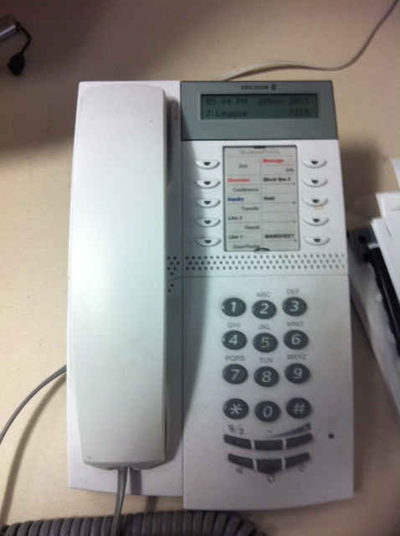
Phone Communication
Consider the situation of others
  Be prepared for your contact to be busy
Control the progression of communication
  If a contact is busy, set a time for a follow up or return call
Leave useful voicemail messages
  Always leave your contact number
Do not nag via voicemail
  Leave ONE message
Your own voicemail greeting must be informative and professional
Notes:
First question when initiating phone conversation:
"Have I called at convenient moment? Do you have … minutes to speak?"
Principle - Not imposing
May be in meeting or doing something urgent, but reluctant to say
Forcing contacts to speak gains only part attention, and causes irritation
Losing "brownie points"
Unlikely to get desired Client benefit
Not convenient
"Sorry to interrupt when busy. When will you be free to talk?"
Agree convenient time for you to call back

Slide 63
E-mail
Professional e-mails should be written as if they are letters
  Grammar and spelling must be correct
  Do not be overly familiar
  Do not lapse into colloquialisms or “txtspk”
Always be mindful that e-mails can be circulated to unintended recipients
Take extra care when wording e-mails
  It is very easy to leave the wrong impression via a poorly worded e-mail
  Students are often guilty of poorly worded e-mails to supervisors, staff or mentors
  Always check – what sort of attitude does your e-mail convey? It’s easy to come across as arrogant or rude

Slide 64
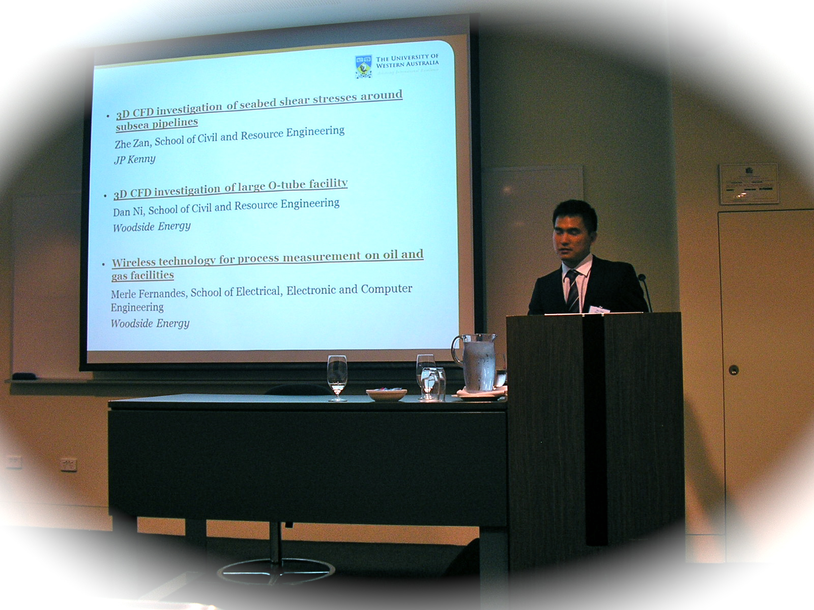
Presentations, Talks and Seminars
CEED Seminar (September)
You will prepare a short (six page) paper
You will deliver a 20 minute presentation (15 minute talk, 5 minutes for questions)
  Students starting at mid-year will be invited to return to deliver a presentation.
You will also participate in event planning and operations.
Most students are also invited to give presentations at their Client’s premises

Slide 65
Preparation is the key to good presentations.

Slide 66
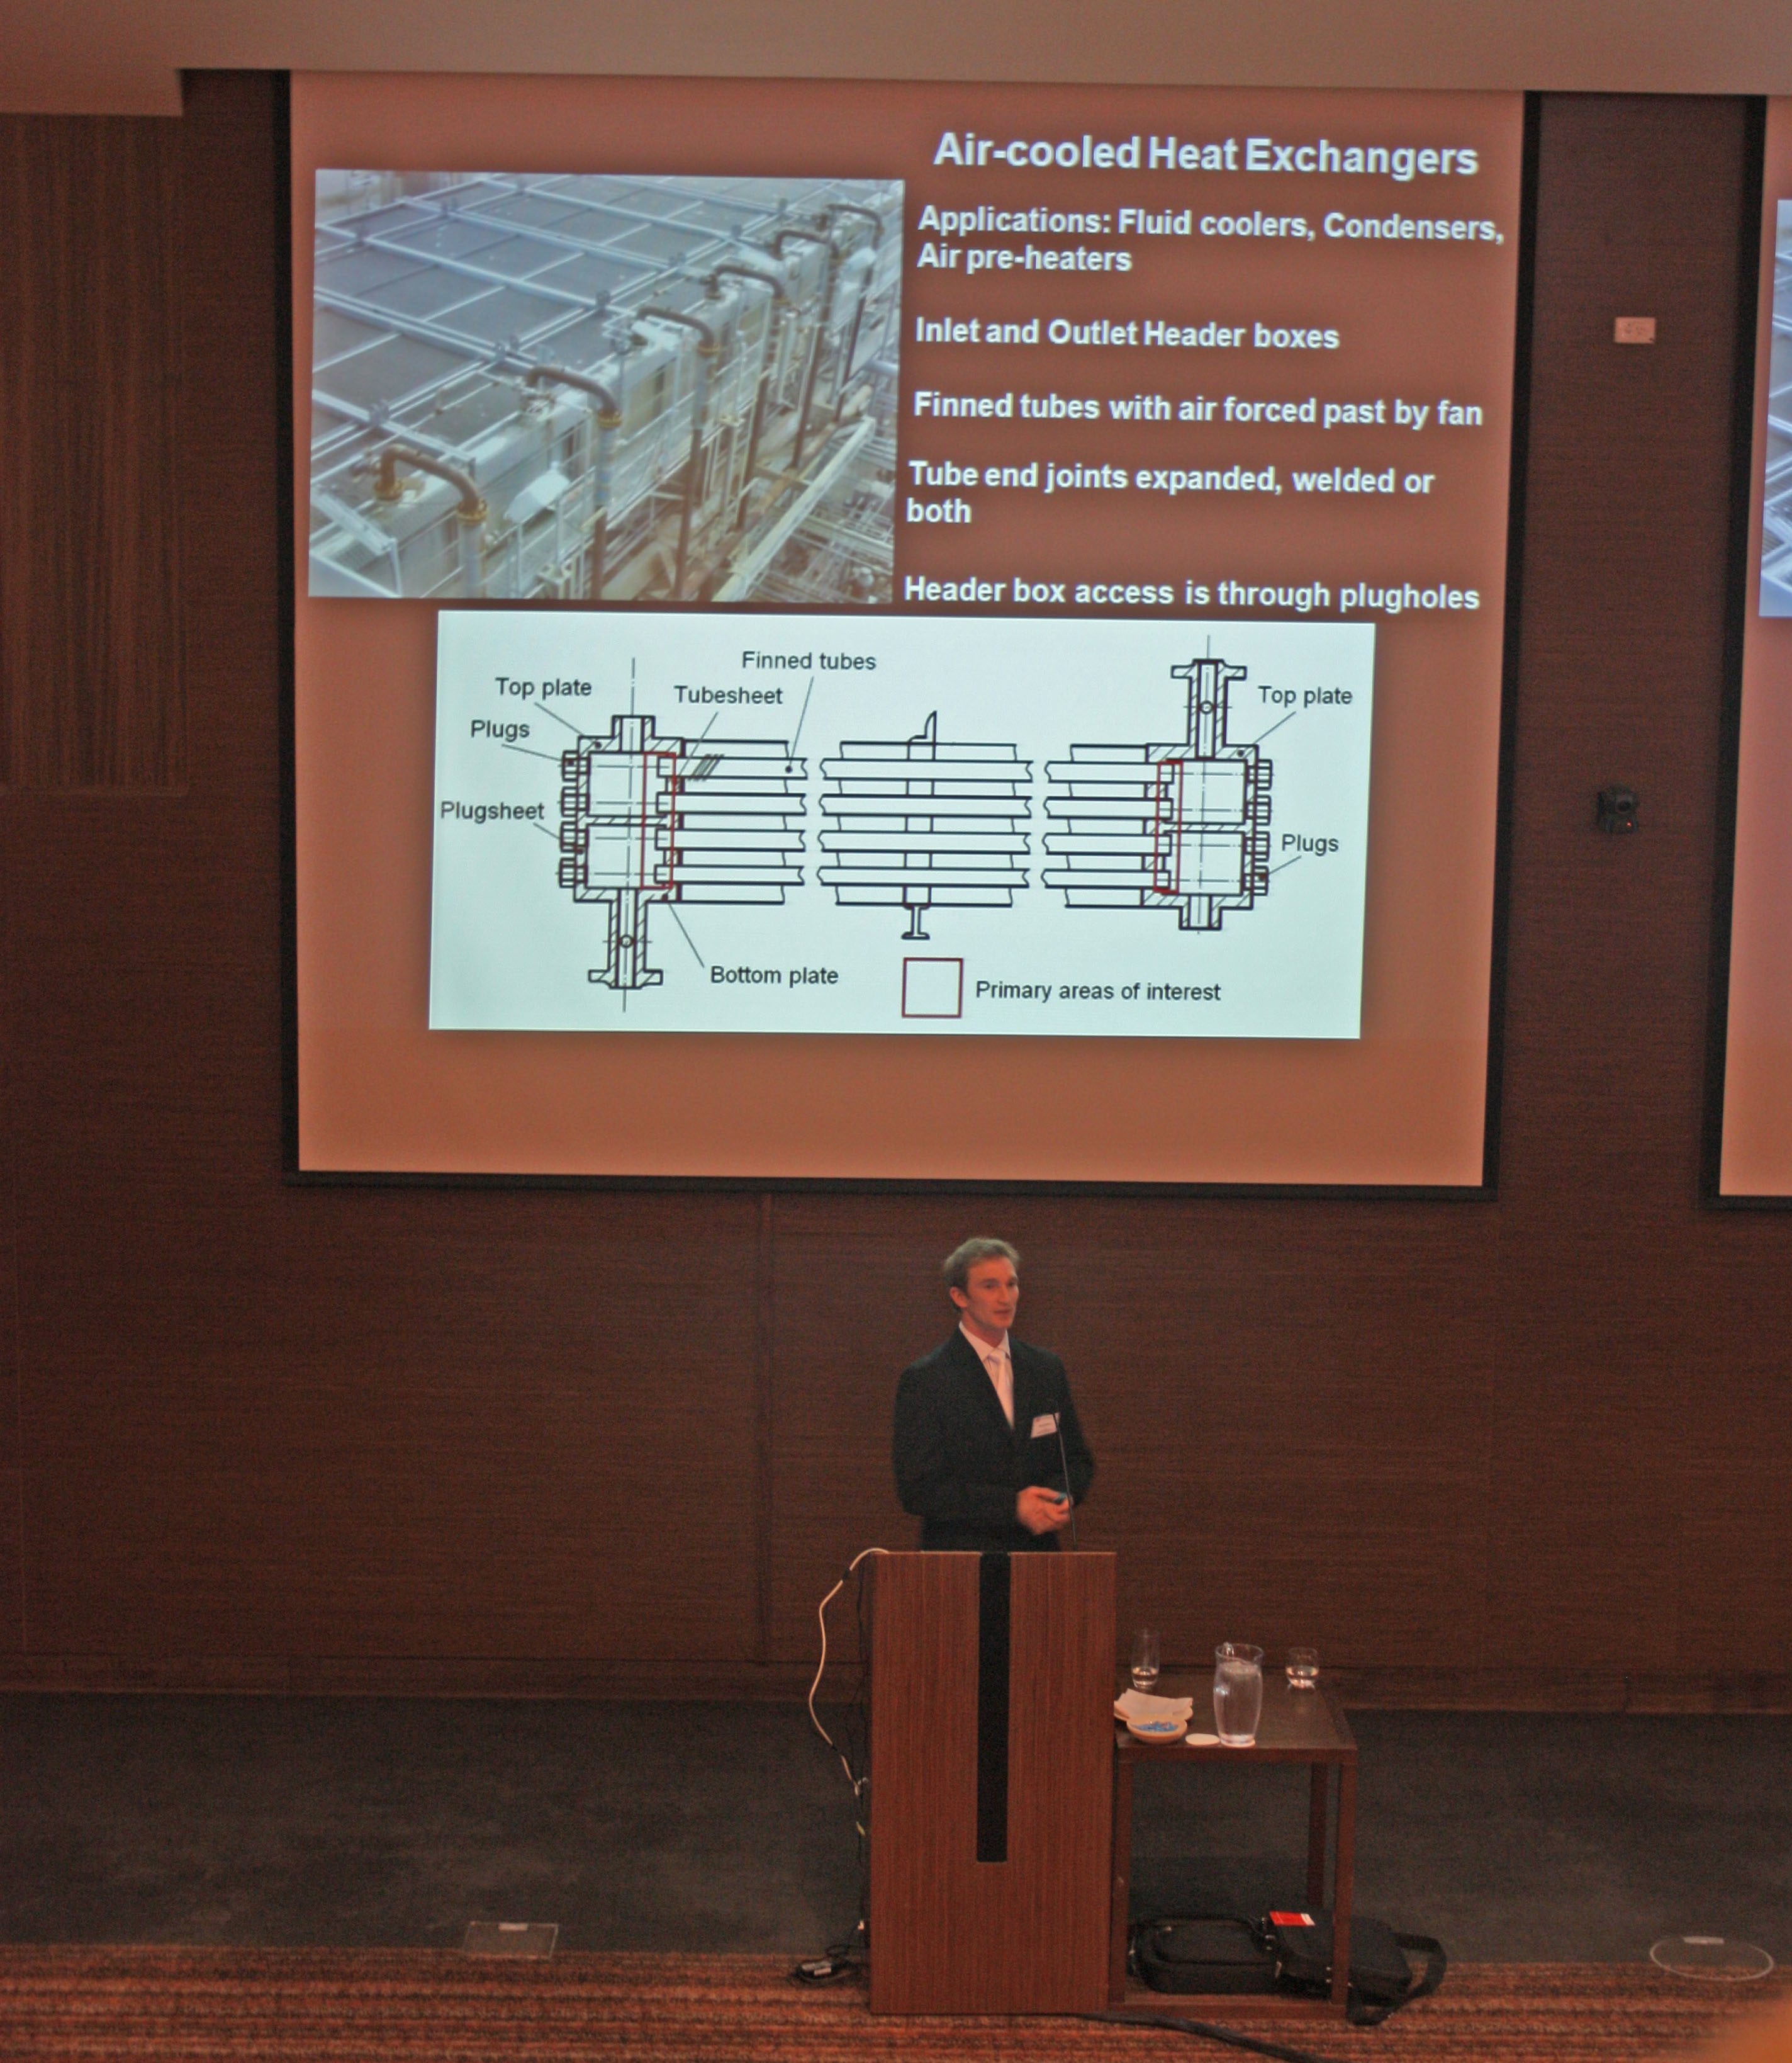
Delivery and Personal Presence
Speaking Volume
Speaking Rate
Mannerisms
Eye Contact
Activity and Engagement

Slide 67
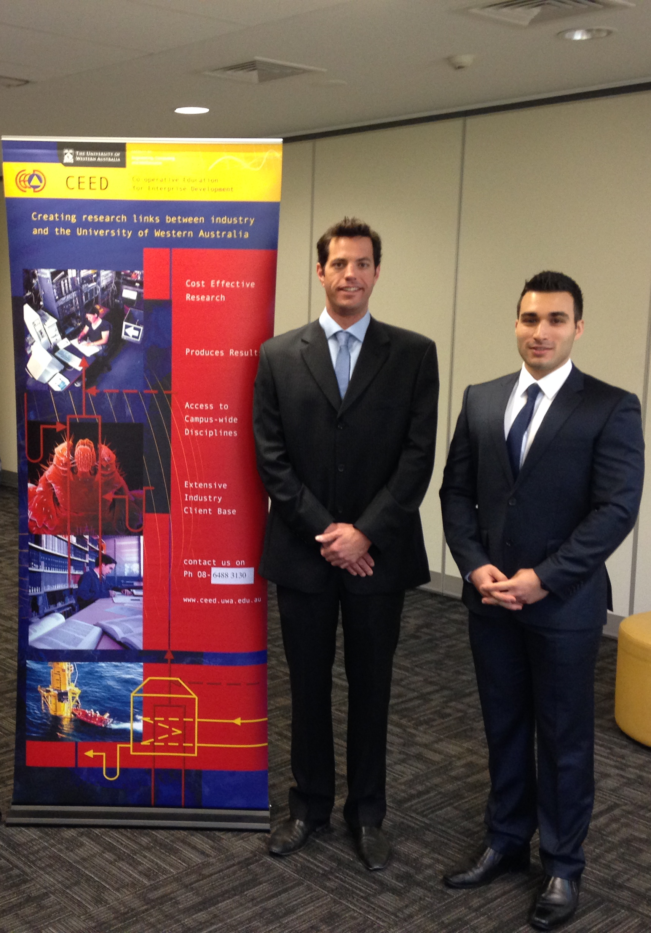
Professionalism
Avoiding Redundancy
Professional Expression
Professional Dress
Meeting Time Limits

Slide 68
Confidence!
Confidence derives from preparation.

Slide 69
Slide Content

Slide 70
Initial Slides
The first 3 slides must establish;
  What the project is about, and what your objectives are
  Why the project is important
  How you are going to achieve your objectives (in a general sense)
If the audience is thinking “WTH?????” after the first 3 slides, then you have lost them
Slides that list the order of the sections of your presentation are worthless.
It is essential to use high impact graphics in your initial explanatory slides – help the audience visualise the issue and its importance.

Slide 71
Slide Presentation
Spelling and (gross) grammatical errors are unforgiveable.
All graphs and images must be appropriately labelled
  Axis titles, legends, units
You must use appropriate (professional) language on your slides, as well as in your verbal expression
Your slide content should reflect the expected level of shared knowledge with the audience
  You MUST tailor your presentations to the audience.

Slide 72
Technical Content
It is essential that all technical content presented be accurate; any obvious errors will lower the audience’s opinion of your work, and diminish its potential impact.

Slide 73
Question Time
Prepare in advance – think about the questions you would ask, and prepare answers for those
  What were the limits of your model or experiment? Why did you settle on particular assumptions? Which choices were arbitrary? Which aspects of your hypothesis are open to challenge?
Listen to questions carefully.
Don’t rush – take a moment to think about your answer.
Don’t take questions personally
Don’t be defensive
Accept that the questioner may be raising a valid point.
You don’t always have to have an answer – but you should have an idea of how to get the answer.

Slide 74
Font Size
All text and image labels must be visible from the back of the room.
Rule of thumb – never use less than 16 point font, and try to stay at 20 point and above for important text.
  This is 20 point (Calibri)
  This is 16 point
  This is 12 point
Note that these limits can vary for different types of font
Be sure to use crisp, clear fonts;
  Georgia (this presentation), Times, Arial, Helvetica, Geneva

Slide 75
Background and Colours
Be careful when selecting backgrounds and slide formats
  “Busy” slide templates can restrict space and obscure information
  Don’t let background colours overwhelm the key information
Ensure that Background and font colours are compatible
  Dark on light or light on dark are the rule – “sort of dark on sort of light” or vice versa is a silly mistake
  Make sure that the background colours are compatible with graphs and images too.
Good
Good
No Good
Stupid

Slide 76
Image Size
Make sure that all image features, symbols and labels are visible at the back of the room
  Lines and text are often “thinned” by the projector – so lines that look good on your screen may not show up well when projected.
  Color definition can also be lost in projection – it can be hard to tell Blacks from Dark Blues, etc
Use judgement in deciding whether to squeeze multiple images or graphs onto a single slide
  Is the point you are trying to make still clear with the smaller images?
  Do you really need to compare the images – or is the point still clearly made with larger images on separate graphs?

Slide 77
Inhibition Ratio ρ_{n}
Three-dimensional ERS arrays of Monodisperse Spheres
V_{f}=0.40
0.01
V_{f}=0.20
V_{f}=0.01

Slide 78
Effect of short range order on Inhibition Ratio;
Three-dimensional ERS monodisperse particle arrays

Slide 79
Session 4
Managing Your Research Project

Slide 80

Project Execution

Slide 81
80% is NOT Good Enough!
The biggest difference between a classroom environment and the real world is that you are judged by results instead of marks.
In the classroom, 80% gets you an A; in practice, something that is 80% right will 100% not work.
In practice, turning in work with errors (or projects that don’t work) makes you look careless and lowers others’ confidence in you.
  Marks are ultimately meaningless. You will only be deemed successful if you deliver something that works!

Slide 82
It’s your project!

Slide 83
It’s your project!
You must take “ownership” of the project for it to be successful.
  You will receive support from your supervisor, the client, the CEED office, school staff, and your fellow students,
  BUT
  You’re the person primarily responsible for the success or failure of the project.
You must take the initiative to keep the project moving in the absence of immediate deadlines or external pressure.
If you get moving on your project earlier, you will have more opportunity explore your project. The more you explore, the better your project will turn out.

Slide 84
Project Activities
Project activities NEVER go smoothly
  Anything that you leave to the last minute WILL get delayed when you can least afford it.
  Sometimes things that are beyond your control will go wrong (this is why we do risk management).
Get your research going as early as possible;
  This will give you the chance to overcome difficulties
  You may identify ways to enhance your project (remember– you are effectively in competition for resources).
Use the holiday breaks– don’t let your project stall during teaching breaks.
  Workshops, libraries and labs are quieter over the break – it can be easier to get things done.
  More importantly, you don’t have other classes in the break.

Slide 85
Site Testing & Sample Collection
Projects involving site testing or sample collection face particular challenges.
  You will have to fit your testing in with operational and maintenance schedules
  Several parties may be involved in setting up and executing the program – and they will each have their own priorities
  The program may involve multiple organisations (client, contractor, community); and all of their schedules will need to align to enable the program to proceed
So – you must start as early as possible to plan and organise the test/sampling programs
Be aware that the timing will be difficult to control – so plan accordingly in your project timeline

Slide 86
Be Pro-active!
Resolve issues as soon as they arise.
  Procrastination is fatal in a one year project
  Problems will not become easier to fix next week (in fact – there will be less time available to address any issues).
Don’t assume that your supervisor or mentor will be available on your timetable – so get material to them early.
  They are busy; you may be one of many students or employees that they are supervising, and they may have other job responsibilities to attend to.
  You have to give your supervisor and mentor time to review and respond thoughtfully to submissions.
Clients and Supervisors respond to your enthusiasm.
  If you’re interested and getting things done, they will take more interest in your work and contribute more.

Slide 87
Meetings
You should set and maintain a regular meeting schedule with your supervisor and client mentor
  Weekly supervisor meetings would be preferred; fortnightly would be the minimum frequency.
  Meetings with the client mentor may be less frequent, depending on the mentor’s commitments.
Set goals to be achieved between meetings
  At each meeting, you discuss with your supervisor and mentor the work done since the last meeting
  Set down what will be done by the next meeting.
Seek regular feedback from your supervisor and mentor
  Ask them to assess your plans and findings.
  Ask for comments on any documents or presentations.

Slide 88
Project Timeline
Make sure you set out definite deadlines for individual tasks.
  Identify regular milestones that will help mark your progress, especially in longer or more complex tasks
Stick to your deadlines!
  Don’t let weekly pressures (or the absence of imminent project submissions) reset your priorities.
  Make time for your project every week – it’s the most important unit you’re undertaking over the next year.
Keep your Gantt chart updated as the project evolves
  Take particular care to identify tasks on the critical path, and keep them on schedule.

Slide 89
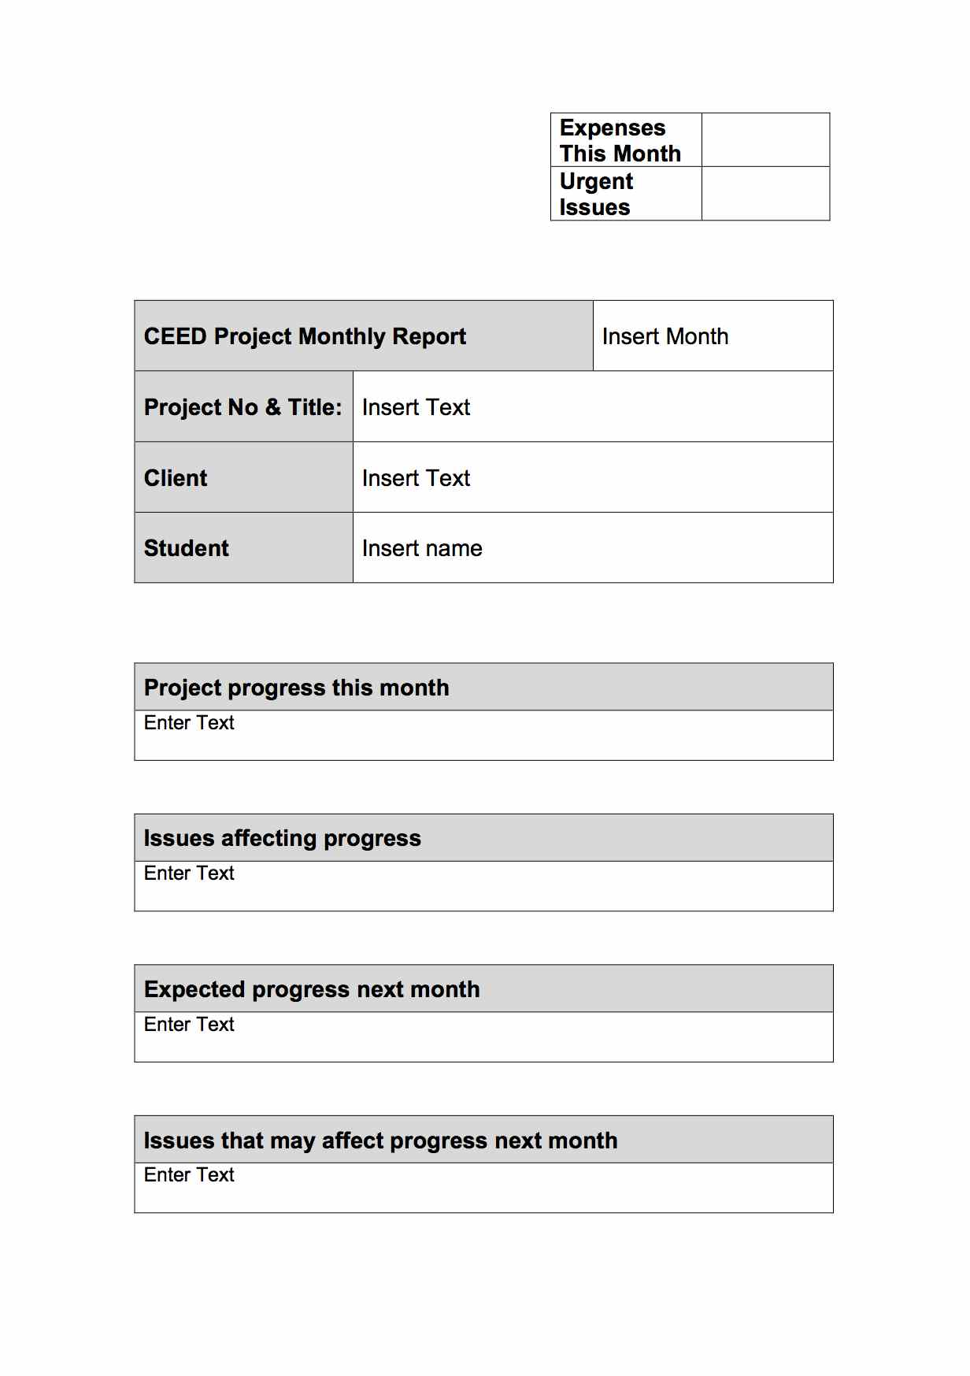
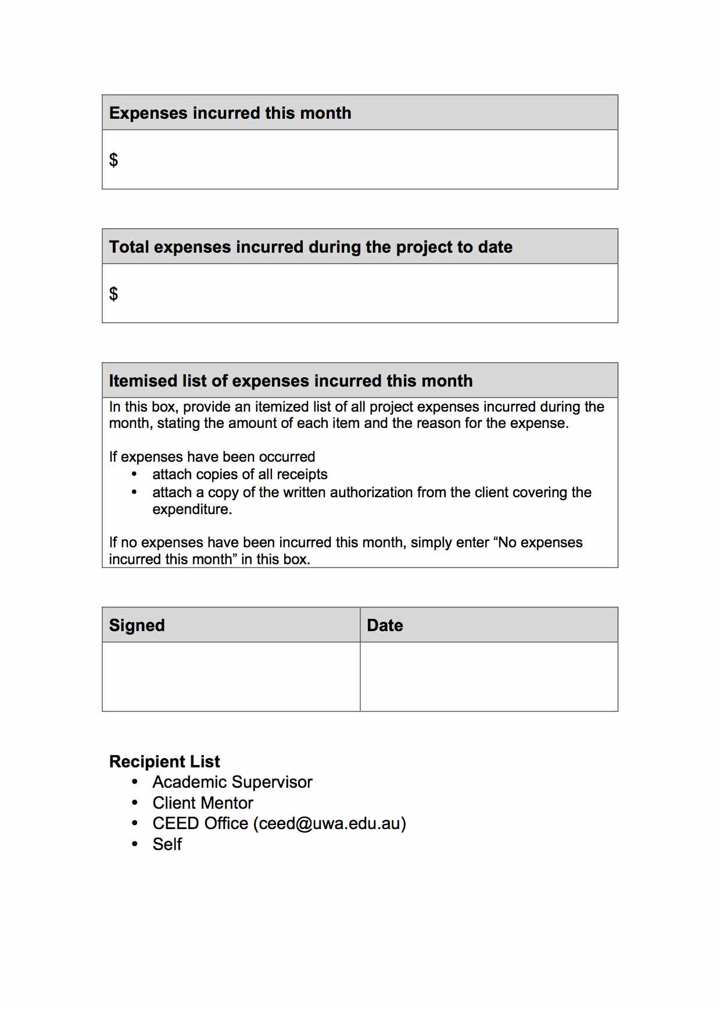
Monthly Report

Slide 90
Monthly Report
You are required to submit a monthly report by 5:00 pm on the first day of each month
The template for the monthly report is available at the CEED website.
The monthly report must be an accurate summary of the status of the project.
  Your supervisor and mentor must have an accurate picture of project status, expenditures and resource needs in order to advise you properly and schedule resources
  The submission of the report should serve as a reminder to update your project timelines
The monthly report will be circulated to the client mentor, supervisor and CEED office.
  It must be professionally prepared and presented

Slide 91
Project Expenditures
The client is responsible for all project expenses.
The client may incur expenditure directly (this is common for travel and accommodation), or we may incur expenditures on the client’s behalf (this is common for workshop expenses, experimental consumables, test rig construction)
We can only incur expenditures on the client’s behalf with the prior written authorisation of the client – you must complete the expenditure authorisation form and have it signed by your mentor, supervisor, and the CEED Director before incurring expenditure
In general, expenditures must be billed to your supervisors’ operating accounts – you should not incur expenditures yourself
The CEED office will bill the client and reimburse your supervisor at the end of the project – this will require you to provide:
  Records of all internal expenditures (eg workshop hours)
  Tax invoices for all purchases

Slide 92
Printing Expenses
$200 is included in the CEED project fee to cover printing expenses
This amount is intended to cover the costs associated with preparing reports and deliverables for the client, supervisors and CEED Office
Allowable expenses include:
  Printing and binding of reports
  Media for transporting digital files (thumb drives, external hard drives, etc)
  Textbooks and photocopying
The allowed amount may only be exceeded with prior written authorisation by the client – they will be billed for the excess
You may incur these expenses yourself – to be reimbursed, you must provide all receipts – itemised tax invoices are the minimum requirement.

Slide 93
Exercise – Monthly Report
Prepare a sample monthly report for the first month of your project.
You have 10 minutes to compile the report – later in the day you will get feedback on the reports.

Slide 94
Studentship
For full final-year/honours/masters projects the studentship is paid in three installments
  1st Installment: Upon receipt of a project brief signed by all parties
  2nd Installment: At the start of the second semester of your final year (if you are up to date with reporting requirements and making satisfactory progress
  3rd Installment: When Client confirms that all deliverables have been received.
For Three Quarter final-year/honours/masters projects the studentship is paid in two installments
  1st Installment: Upon receipt of a project brief signed by all parties
  2nd Installment: When Client confirms that all deliverables have been received.
All payments are contingent on being up to date with monthly reports

Slide 95
Report Preparation

Slide 96
Why Prepare a Report?
To communicate your project’s motivations, objectives, methods and findings to others
Obviously, your report will be marked, but you will find that if you focus on effective communication, the mark will take care of itself
When making decisions on whether your report is effective, place yourself in the reader’s shoes;
  Would someone reading this text understand what you are thinking?
  Does this figure or graph convey the information that you wish to convey to the reader effectively?
The reader is NOT a mind-reader; all they have to work with is what you provide in the report

Slide 97
Report Audience
When preparing any report, you must take into account the expertise and motivations of the target audience
For your report, the audience will include
  Staff at your client enterprise; these staff may have extensive experience, but may not be familiar with specialized techniques
  Management staff at client enterprises; these individuals may or may not have specific expertise
  Recruiting officers at potential employers; these individuals may or may not have specific expertise
  Academic Staff in your school; experienced researchers and teachers
  Future students; experience similar to your own

Slide 98
Audience Motivations
Implementing your recommendations, or evaluating your recommendations for implementation.
Deciding whether to support continuing research on the subject
Following up or extending your research
Determining whether to hire you
Determining where you should be assigned in an organisation
Comparing your research with research done elsewhere
And…………..
Marking
Notes:
While we all hope your CEED project start-up will go smoothly and according to plan, sometimes there are unavoidable delays. Aim to achieve as much as possible of the following before you start site work. In some cases that will not be possible, in which case, simply achieve what you can and aim to get the rest done in the early part of the first site work period.
Whatever your starting date, you will not make much progress on the actual solution of the problem before starting site work. Helpful goals would be to:
know exactly what you are setting out to achieve, and why;
have composed, agreed upon, and signed the Project Brief;
have planned how you will set about tackling the work;
have requested the resources needed at the CEED Partner's site and the university;
have started accumulating relevant reference material;
have set up the structure for your planning and documentation system;
have begun to build up key skills and knowledge;
be ready to outline your approach in a brief presentation.
It is very beneficial for you to be ready for more detailed work by the time you commence work on site.

Slide 99
Project Summary
In some respects, the most important element of any report
For busy readers, the summary may be the only thing they read – it will ALWAYS be the first thing they read
The summary must capture the reader’s attention – so take care in preparing it.
The summary must provide a clear, concise description of
  The reasons for undertaking the project
  The project objectives
  The methods by which the objectives will be achieved
  Key conclusions and recommendations (highlighting costs of implementation and benefits, advances in the state of the art, novel capabilities or features of a new design, as appropriate)
The summary should usually be limited to 250 words (always less than one page)

Slide 100
Introduction and Project Objectives
The introduction sets out:
  The nature of the issue being addressed
  The importance of the issue
  The past history in the area and the current state of the art
  The objectives, and the reasons for pursuing those objectives.
Context is important: why is the project important to the field, sponsor or community? How does the project advance the state of the art?
What benefits accrue from the achievement of the objectives?
A brief description of the structure and contents of the thesis may be included
Notes:
While we all hope your CEED project start-up will go smoothly and according to plan, sometimes there are unavoidable delays. Aim to achieve as much as possible of the following before you start site work. In some cases that will not be possible, in which case, simply achieve what you can and aim to get the rest done in the early part of the first site work period.
Whatever your starting date, you will not make much progress on the actual solution of the problem before starting site work. Helpful goals would be to:
know exactly what you are setting out to achieve, and why;
have composed, agreed upon, and signed the Project Brief;
have planned how you will set about tackling the work;
have requested the resources needed at the CEED Partner's site and the university;
have started accumulating relevant reference material;
have set up the structure for your planning and documentation system;
have begun to build up key skills and knowledge;
be ready to outline your approach in a brief presentation.
It is very beneficial for you to be ready for more detailed work by the time you commence work on site.

Slide 101
Literature Review
The literature review may be blended into the introduction or presented as a separate chapter.
The purpose of the literature review is to establish the state of the art in the area that you are working in.
  For investigative research, this will mean reviewing the academic literature.
  For design projects, this will mean identifying current approaches to solving the problem of interest (or similar problems)
  For industrial projects, this will entail reviewing standards and current operating practices.
Remember – it’s important to REVIEW the literature critically. It’s not a literature “survey”.

Slide 102
Process
The guiding principle for this section is that it should provide any information that would be necessary for someone to repeat your work.
The nature of this section will depend on the project
  Experimental Method
  Model Formulation
  Design Approach
  Data Collection
Providing detailed information is critical
  Your findings are meaningless if the reader cannot tell how you obtained them.
  Figures are essential.
  Design criteria MUST be defined for design projects
Notes:
While we all hope your CEED project start-up will go smoothly and according to plan, sometimes there are unavoidable delays. Aim to achieve as much as possible of the following before you start site work. In some cases that will not be possible, in which case, simply achieve what you can and aim to get the rest done in the early part of the first site work period.
Whatever your starting date, you will not make much progress on the actual solution of the problem before starting site work. Helpful goals would be to:
know exactly what you are setting out to achieve, and why;
have composed, agreed upon, and signed the Project Brief;
have planned how you will set about tackling the work;
have requested the resources needed at the CEED Partner's site and the university;
have started accumulating relevant reference material;
have set up the structure for your planning and documentation system;
have begun to build up key skills and knowledge;
be ready to outline your approach in a brief presentation.
It is very beneficial for you to be ready for more detailed work by the time you commence work on site.

Slide 103
Results & Discussion
The guiding principle for this section is that it should describe what has been done, and demonstrate how well the findings are understood.
Focus on presenting “analysed” results
  Raw data may be provided in appendices
  Use graphs and tables as appropriate
For design studies, the final design, and its performance of the design will represent “results”.
Take care to evaluate how well your presentation communicates the results to the reader
  Graphic comparisons are particularly powerful
  When comparing results, select a form that keeps the items being compared on a single page
Notes:
While we all hope your CEED project start-up will go smoothly and according to plan, sometimes there are unavoidable delays. Aim to achieve as much as possible of the following before you start site work. In some cases that will not be possible, in which case, simply achieve what you can and aim to get the rest done in the early part of the first site work period.
Whatever your starting date, you will not make much progress on the actual solution of the problem before starting site work. Helpful goals would be to:
know exactly what you are setting out to achieve, and why;
have composed, agreed upon, and signed the Project Brief;
have planned how you will set about tackling the work;
have requested the resources needed at the CEED Partner's site and the university;
have started accumulating relevant reference material;
have set up the structure for your planning and documentation system;
have begun to build up key skills and knowledge;
be ready to outline your approach in a brief presentation.
It is very beneficial for you to be ready for more detailed work by the time you commence work on site.

Slide 104
Results & Discussion (cont.)
The purpose of the discussion is to place your results in context.
  Compare the findings with any original expectations.
  Compare the findings with the pre-existing state of the art.
  Compare the proposed approach with alternatives.
  Discuss the limitations of the current project.
It is important to assess the limitations of a technique, in order to properly apply results.
Arbitrary choices should be identified, and alternative approaches should be considered in the discussion.
Remember – all statements and arguments in your report must be supported, either by your results, or information available in the literature.

Slide 105
Every statement and conclusion in a professional report must be supported by accepted literature or your results and deductions

Slide 106
Conclusions and Future Work
Conclusions should state concisely the most important findings of the project.
  Assess whether or not the objective of the project have been achieved.
  Identify any future work arising from the project (unresolved issues, or steps for implementation).
While the conclusions will generally brief, care should be taken in writing this section.
  Remember, it will be the last thing that the audience reads, so it will be the last thing on their mind before they make a decision on the future of your project (in professional practice), or on your grade (right now)!
Last impressions are important too!

Slide 107
Your reports must stand on their own as documents!
Remember that your reports may have a life within the client organisation that extends far beyond your participation in the project
  The report must make sense even when you’re not around to explain it.
  The methodology and recommendations in particular must be clear to people who were not original participants.
  You never know who may end up seeing your report – they are often circulated widely, including to senior personnel within the client enterprise.
Any additional deliverables (such as manuals) must be prepared with the intended audience in mind

